Slide 1
Using Newton’s Laws
Physics 1425 Lecture 7
Michael Fowler, UVa.

Slide 2
Today’s Topics
Weight: the force of gravity
The Normal Force: a surface pushes back
Free Body Diagrams: finding the total force on a body

Slide 3
Weight: the Force of Gravity
Newton introduced the idea of a gravitational force to explain Galileo’s “natural downward acceleration”.
Previously, force was only used to describe direct physical contact forces, the idea of a gravitational force seemed weird—kind of irrational and magical.

Slide 4
Weight and Inertial Mass
All falling objects have the same acceleration (when air resistance is eliminated), so applying
the gravitational force on an object—its weight—must be directly proportional to its inertial mass. (It isn’t obvious why this should be true!)
If an object is taken to the Moon, its inertial mass doesn’t change—it takes the same energy to accelerate a car. But its weight does change.

Slide 5
The Normal Force
Right now, the force of gravity is pulling us all downwards—but we’re not moving!
What about ?
Remember is the total force on a body.
If the floor disappears, I will accelerate downwards!

Slide 6
The Normal Force
Conclusion: the floor is providing the force balancing that of gravity: it’s called the normal force.
Question: how can something as inert and immoveable as the floor provide a force?
Clue: how does a spring balance provide a force to measure weight?

Slide 7
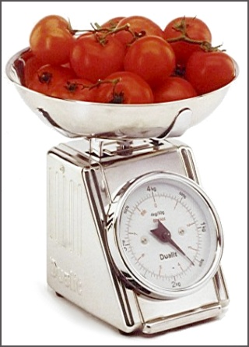
Normal Force and Springiness
When the tomatoes are put on the scale, it moves down, compressing a spring until the spring’s force balances gravity.
The floor is elastic too! Where you stand, it sags a little, and pushes back like a very stiff spring.

Slide 8
Clicker Question I stand on roller skates facing a wall. I reach out and push against the wall, I accelerate backwards. What force caused my acceleration?
My arm and back muscles
My pushing against the wall
The normal force from the wall
Friction between the skates and the floor

Slide 9
Clicker Question I stand on roller skates facing a wall. I reach out and push against the wall, I accelerate backwards. What force caused my acceleration?
My arm and back muscles
My pushing against the wall
The normal force from the wall
Friction between the skates and the floor
A body can only be accelerated by an outside force—and friction only helps if I actively push against the floor, as in skating.

Slide 10
Clicker Question What is the normal force from the elevator floor on a person weighing mg, if the elevator is accelerating upwards at 0.1g?
1.1mg
mg
0.9mg
None of the above

Slide 11
Clicker Question What is the normal force from the elevator floor on a person weighing mg, if the elevator is accelerating upwards at 0.1g?
1.1mg
mg
0.9mg
None of the above
Link to movie!

Slide 12
Tension!
In Newton’s original statement of his Third Law, he features a horse pulling a rope attached to a stone.
The tension in the string means that if the stone is subject to a certain force from the horse’s efforts, the horse feels an equal and opposite force from the tug of the string.
The string is pulling inwards at both ends.

Slide 13
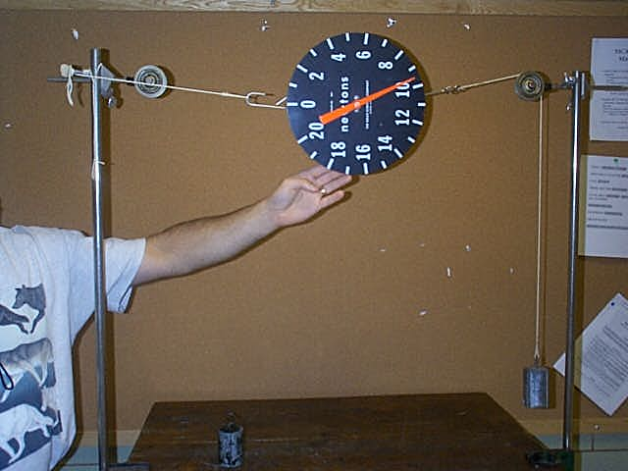
Tension Puzzle…
A one kg mass hangs from the string, the other end is looped over a hook.
Suppose the looped end of the string is taken from the hook, put over the pulley, and a one kg mass is hung from that end too. What will the spring scale read now?
About the same
About double

Slide 14
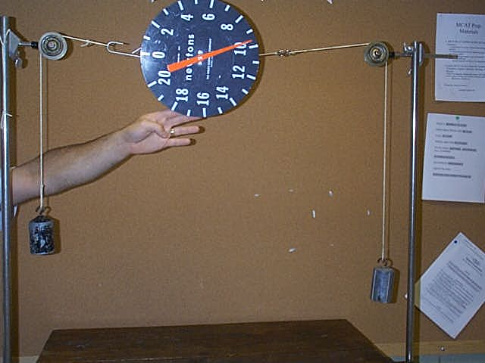
Tension Puzzle Answered
We did the experiment, this is what we saw:
The tension in the string is the weight of one kg, 9.8N. In the first case, the string was pulling the hook with 9.8N force, and the hook was pulling right back!

Slide 15
Free Body Diagrams
To apply Newton’s Laws to find how a body moves, we must focus on that body alone and add all the (vector) forces acting on it.
The diagram showing all the forces on one body (or even part of a body) is called a “free body diagram”—we’ve “freed” the body from the rest of the system, representing everything else just by the forces on this body.
The net (total) force then goes into .

Slide 16
Clicker Question
The strings shown are
all at 120° to each other.
For the vertical string,
T = Mg. What is T in one
of the sloping strings?
Mg/2
Mg
Mg/√3

Slide 17
Clicker Question Answer
The strings shown are all at 120° to each other. For the vertical string, T = Mg. What is T in one of the sloping strings?
Mg/2
Mg
Mg/√3
The knot where the strings meet
isn’t moving—so the three forces
acting there add to zero.
They form an equilateral
triangle, so all forces have the
same magnitude (you can also balance vertical components.)

Slide 18
Further Explanation…
The knot where the strings meet isn’t moving—so the three forces
acting there add to zero. If you add together three vectors, the sum is the vector going from the
tail of the first vector to the head of the last
one. If they add to zero, the head of the last must
be at the tail of the first! So they form a triangle—
And the sides of this triangle must be in the direction of the original forces: drawing the angles right determines the relative lengths of the sides.
You can also balance vertical components: the slanting strings are at 30° to the horizontal, so the sloping string tension force has a vertical component equal to Tsin30 = T/2.

