Slide 1
More Hydrostatics
Physics 1425 Lecture 26
Michael Fowler, UVa

Slide 2
Basic Concepts
Atmospheric Pressure
Buoyancy: Archimedes’ Principle

Slide 3
Clicker Question
Galileo once observed that even a carefully constructed pump, situated at ground level, was not able to draw up water out of a well deeper than about thirty feet.
Is this still the case?
Yes
No

Slide 4
How Suction Pumps Work
Galileo hadn’t realized that a suction pump just lowers air pressure above the water in the pipe, then the outside atmospheric pressure pushes it up—and there’s a limit to how far up that pressure can push.
Galileo’s pupil Torricelli was the first to understand, he built the first mercury barometer. He’d been ordered by his Grand Duke to figure out how to improve the pumps.

Slide 5
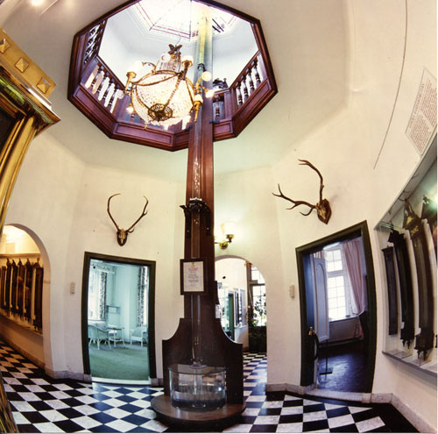
Guinness Certified Largest Barometer!
This is a water barometer in the Netherlands.
About how tall is the column of water?
20 ft
30 ft
40 ft
50 ft

Slide 6
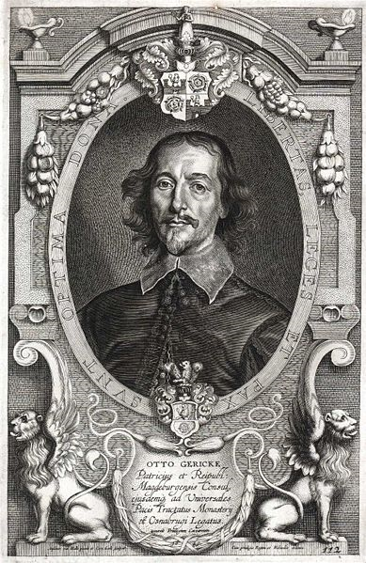
Otto von Guericke
… was impressed by Torricelli’s discovery of atmospheric pressure.
He built a water barometer. He was the first to forecast weather based on barometric observations.
He found a great way to demonstrate atmospheric pressure…

Slide 7
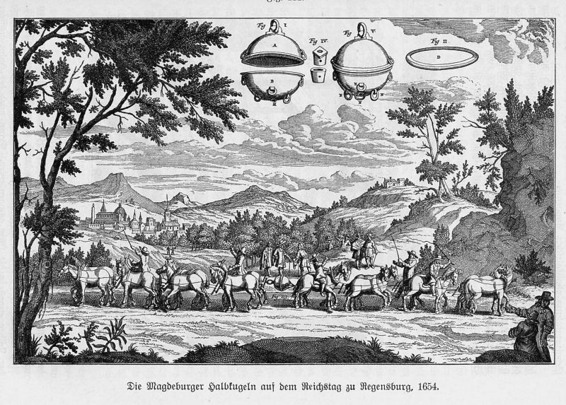
Magdeberg Hemispheres, 1654

Slide 8
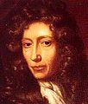
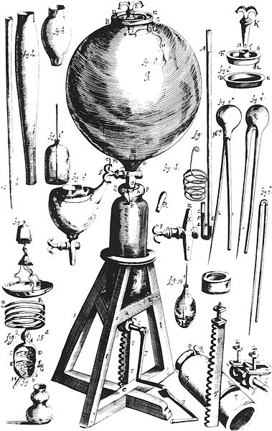
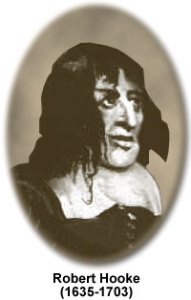
Boyle and Hooke Build a Pump
Inspired by von Guericke’s hemispheres, Boyle and Hooke constructed an air pump in Oxford in1659.
A colleague, Papin, found an easier way to use air pressure—use steam to drive out air, then condense it (see demo).
This led directly to the first steam engine in 1698!

Slide 9
Buoyancy Force
X
Any object immersed in a fluid feels pressure forces all around it. Since the pressure is greater at greater depth, there is a net upwards force—this is called buoyancy.
Suppose the underwater object is replaced with a ghost: an extremely thin plastic sheet of the same identical shape, just enclosing the fluid.
The pressure forces on this ghost will be identical, and they will be just enough to support the weight of the fluid inside.

Slide 10
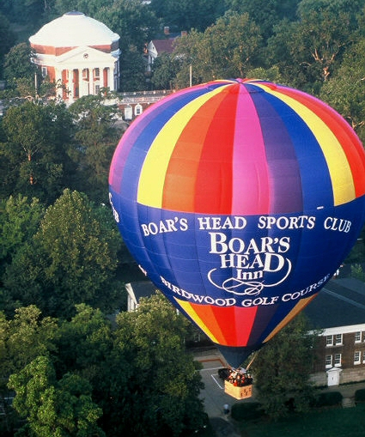
Archimedes’ Principle
A body immersed (or partially immersed) in a fluid experiences a net upward buoyancy force equal to the weight of the fluid displaced.

Slide 11
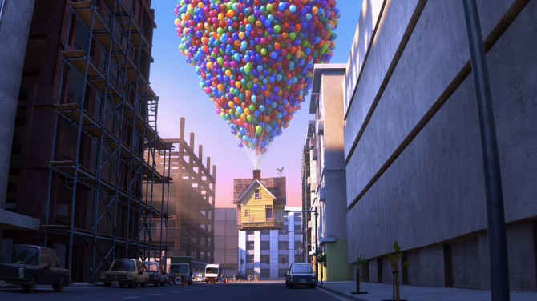
I don’t think so…
Approximate the balloons as a sphere of helium, guess the radius, hence the lift. How does it compare with the weight of a house? (Not to mention the balloons!)

Slide 12
Clicker Question
A glass of water filled to the brim has an ice cube floating in it.
As the ice cube melts, the water
Spills over the brim.
Stays the same.
Gets a little lower.

Slide 13
Clicker Question
A glass of water filled to the brim has an ice cube inside, stuck to the bottom.
As the ice cube melts, the water
Spills over the brim.
Stays the same.
Gets a little lower.

Slide 14
Clicker Question
A glass of water has an ice cube floating in it. The cube is 90% submerged.
For an exactly similar cube in a glass of water at a future resort on the Moon, where gravity is a lot less,
The cube will ride higher in the water.
The cube will ride lower in the water.
The same percentage will be submerged as on Earth.

Slide 15
You are sitting in a rowing boat in a small pond. There are some bricks in the boat. You take the bricks and throw them into the pond. They sink to the bottom.
What happens to the water level in the pond, as measured at the bank?
It falls.
It rises.
It stays the same.

