Slide 1
Physics 1425: General Physics I
Spring 2010
Michael Fowler
Room 307, Physics
Home Page

Slide 2
Today’s Topics
Course arrangements, syllabus outline.
Nature of science: observation and measurement.
Accuracy, significant figures.
Units, mass of water, estimation.
Unit conversions, useful approximations.

Slide 3
Basic Outline
The course has three main parts, each about a month, each followed by a midterm-like exam.
Dynamics, Newton’s Laws, gravitation.
Work, energy and momentum conservation, torque and rotational dynamics.
Fluids, simple harmonic motion, heat and thermodynamics.

Slide 4
Part I: Dynamics
Preliminaries: measurement, estimation.
One-dimensional motion: velocity and acceleration.
Projectile motion, vectors.
Newton’s Laws of Motion.
Vector force diagrams. Friction.
Dynamics of circular motion.
Gravitation: Kepler’s Laws, Newton’s Law.

Slide 5
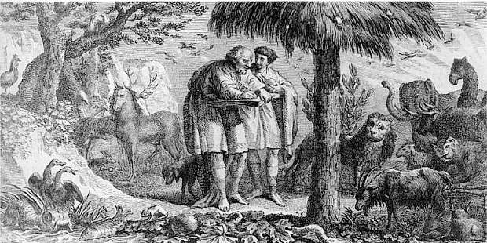
Nature of Science www.mlahanas.de/Greeks/AristotleBiol.htm
Observation: here’s Aristotle observing and noting.
Theorizing: finding general laws.
Checking: observe more and do experiments to check the theory!
Aristotle’s Law of Motion:
Things move if pushed. Otherwise not. Wrong!

Slide 6
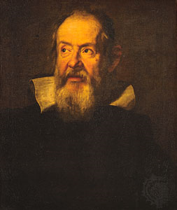
Better Observation: Galileo
Invented the telescope, found the Moon not a perfect sphere, as believed.
Studied motion: imagined a rolling ball without friction: would continue indefinitely, without being pushed!

Slide 7
Measurement and Uncertainty
Galileo, the first real physicist, also experimentally measured acceleration: the rate of increase of speed, of a falling object.
He found the acceleration to be constant, at his level of accuracy.
How do we quantify level of accuracy?
Need explicit statement of expected error:
Example: timing a 100 yard run with a stopwatch,
10.5± 0.1 seconds: Most likely 10.4 to 10.6 secs.

Slide 8
Significant Figures
Number of reliably known digits: not counting initial zeroes.
Examples: 62.0 three sig figs
0.0033 two sig figs
It’s a measure of claimed accuracy.

Slide 9
Clicker Question!
0.0120 has how many significant figures?
2
3
4
5

Slide 10
0.0120 has three significant figures: the final three, the 120.
Putting that 0 at the end means the writer believes the true value is closer to 0.0120 than it is to 0.0119 or to 0.0121.
Writing 0.012 would just mean closer to 0.012 than to 0.011 or 0.013, so it could be 0.0116 .

Slide 11
Important
The accuracy of output of a calculation cannot exceed the accuracy of any of the input!
Calculators don’t know this—you need to:
1.000/7.0 = 0.14 (correct)
NOT 0.142857142857…
DON’T write down meaningless digits!
(that 7.0 might more precisely be 7.03 or 6.96)

Slide 12
SI Units
Time: unit 1 second: defined as time for a certain excited atom (cesium) to make a specified number of oscillations.
Length: unit 1 meter: defined as distance light travels in a specified fraction of a second.
(The actual number of cesium atom oscillations (about 9 billion) is in the book, as is the precise distance—laser jocks know the speed of light is about one foot per nanosecond, but that’s non-SI.)

Slide 13
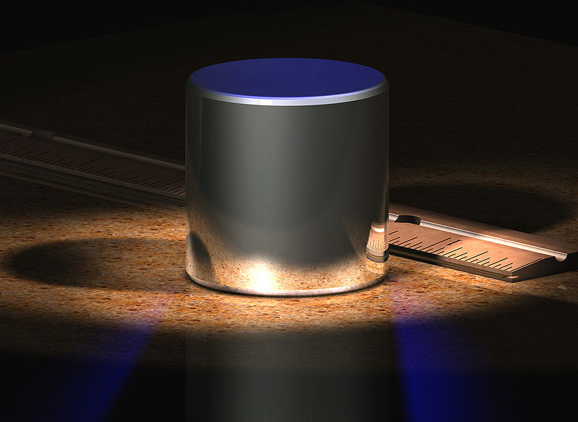
SI Unit: Mass
The unit of mass is the kilogram, defined as the mass of a chunk of platinum in Paris, shown here.
From: http://en.wikipedia.org/wiki/File:CGKilogram.jpg
In2011, a committee will recommend a more fundamental atomic definition.

Slide 14
Useful Fact: the Mass of Water
One liter of water has a mass of one kilogram.
One cubic meter is 1,000 liters.
One cubic meter of water has a mass of 1,000 kg, one metric ton, about 2,200 lbs.

Slide 15
Clicker Question: what is your volume in cubic meters, approximately?
0.3
0.2
0.1
0.07
0.05

Slide 16
Powers of Ten the video
Review Scientific Notation:
1,234,000 = 1.234 x 10⁶
0.0000123 = 1.23 x 10⁻⁵
Review factors of powers of 10 prefixes:
Most common are: (up) kilo, mega, giga, tera, …
(down) milli, micro, nano, pico, …
Each up or down from the next by a factor of 1,000

Slide 17
Converting Units
We’ll work in SI units: but in the US other units are more common.
Exact conversion factors are in the book and elsewhere
BUT it’s useful to memorize approximate equivalents for making rough estimates!
Examples ….

Slide 18
Useful Approximations
1 ft ≈ 30 cm 1 meter ≈ 1.1 yards
5 miles ≈ 8 kilometers
50 mph ≈ 80 kph ≈ 22 m/sec
1 kg ≈ 2.2 lbs (technically, kg is mass, lb is weight—so this isn’t true on the Moon!)
1 gallon ≈ 4 liters

Slide 19
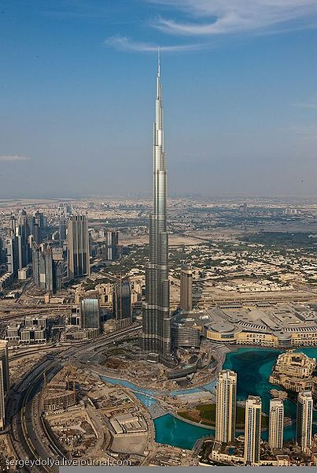
Rough Estimation
The new Dubai skyscraper is just over 800 meters high.
The view from the top extends to about 100 km.
What is the radius of the Earth?
http://en.wikipedia.org/wiki/File:Dubail21.jpg

Slide 20
D is the top of the Dubai tower, F is the far horizon, C is the center of the Earth. DF is perpendicular to FC.
If the radius of the Earth is R, and the tower has height h, and the furthest visible distance is d, then R² + d² = (R + h)².
D
F
C
So d² = 2Rh + h², but h is much smaller than R, so the h² is negligible, we can say d² = 2Rh.

Slide 21
If a replica of the Dubai tower were erected on the Moon, how far away would you be able to see the Moon’s surface from the top?
(The Moon’s diameter = 0.25 Earth diameters, approximately.)
400 km
200 km
100 km
50 km
25 km

