Slide 1
Spares

Slide 2
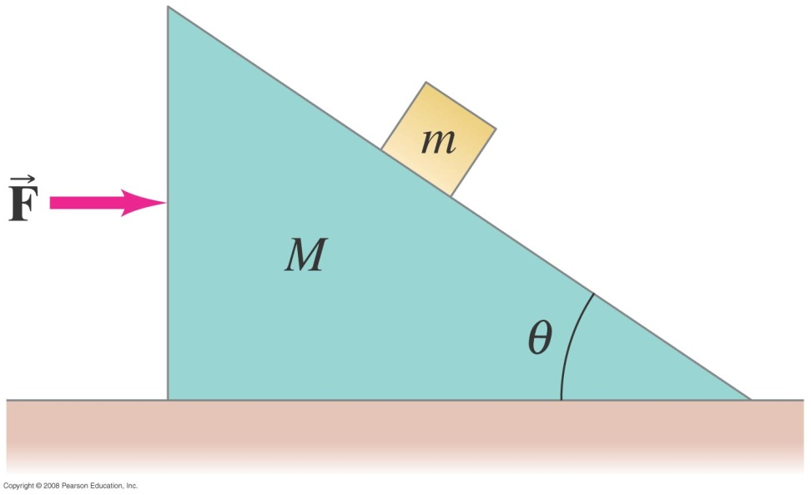
Problem from Book
A small block of mass m rests on the sloping side of a triangular block of mass M which itself rests on a horizontal table as shown in Fig. 4–47. Assuming all surfaces are frictionless, determine the magnitude of the force that must be applied to M so that m remains in a fixed position relative to M (that is, m doesn’t move on the incline). [Hint: Take x and y axes horizontal and vertical.]

