Slide 1
Projectiles
Physics 1425 Lecture 5
Michael Fowler, UVa.

Slide 2
Reminder: Galileo’s Laws of Motion
Neglecting air resistance and friction, Galileo claimed:
Horizontal motion: (ball rolling on table) an object would continue to move at constant velocity unless pushed.
2. Vertical motion: a falling body would accelerate downwards at a uniform rate.

Slide 3
Galileo’s Law for Projectiles
He asked himself: what would happen if the ball rolled off the table?
He claimed (and established experimentally) that the balls uniform horizontal motion would continue as before –
BUT natural vertical falling motion would be added!
He termed the result “compound motion”.

Slide 4
Here’s Galileo’s own picture … and here’s a link to an animation.

Slide 5
Equation for the Trajectory
Taking t = 0 to be when the ball rolls off the edge, and the origin O at that point,
from which
The standard parabola equation is y = ax², so this is half of an upside-down parabola.

Slide 6
Clicker Question
Suppose that as the ball rolling across the table goes over the edge, it touches another ball that was just balanced on the edge. Assume the first ball’s trajectory is not changed, the second ball falls vertically down.
The rolling ball hits the ground first
The dropping ball gets there first
They hit the ground at the same time

Slide 7
Car Goes Horizontally Over Cliff
Position at 1 second intervals (v₀ = 20 m/s)
g=0 trajectory
in red
Taking g = 10, positions are (0, 0), (20, -5),
(40, -20), (60, -45).
Velocities and Speeds at 1 second intervals:
Speeds are approx:
20, 22, 28, 36 m/s.

Slide 8
Full Projectile Path
A projectile is shot at some upward angle from the origin: see animation.
Galileo tells us the horizontal motion is just steady velocity, the vertical motion is the same as that of a ball thrown directly upwards.
Therefore
Eliminating t gives a parabolic curve through O:

Slide 9
Vector Picture of Projectile Motion
Position at 1 second intervals (notice it falls below straight line: the g =0 trajectory).
Velocities and Speeds at 1 second intervals.

Slide 10
ConcepTest 3.5 Dropping a Package
1) quickly lag behind the plane while falling
2) remain vertically under the plane while falling
3) move ahead of the plane while falling
4) not fall at all
You drop a package from a plane flying at constant speed in a straight line. Without air resistance, the package will:
Notes:
Click to add notes

Slide 11
ConcepTest 3.5 Dropping a Package
1) quickly lag behind the plane while falling
2) remain vertically under the plane while falling
3) move ahead of the plane while falling
4) not fall at all
You drop a package from a plane flying at constant speed in a straight line. Without air resistance, the package will:
Both the plane and the package have the same horizontal velocity at the moment of release. They will maintain this velocity in the x-direction, so they stay aligned.
Follow-up: what would happen if air resistance is present?

Slide 12
ConcepTest 3.6c Dropping the Ball III
A projectile is launched from the ground at an angle of 30°. At what point in its trajectory does this projectile have the least speed?
1) just after it is launched
2) at the highest point in its flight
3) just before it hits the ground
4) halfway between the ground and the highest point
5) speed is always constant
Notes:
Click to add notes

Slide 13
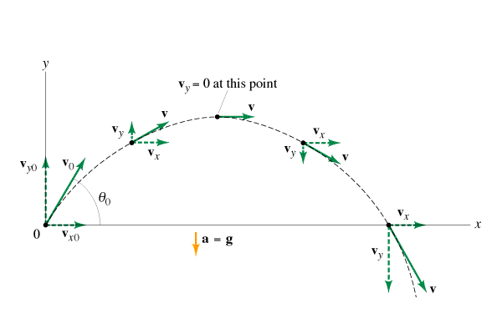
ConcepTest 3.6c Dropping the Ball III
A projectile is launched from the ground at an angle of 30º. At what point in its trajectory does this projectile have the least speed?
1) just after it is launched
2) at the highest point in its flight
3) just before it hits the ground
4) halfway between the ground and the highest point
5) speed is always constant
The speed is smallest at the highest point of its flight path because the y-component of the velocity is zero.

Slide 14
Hang Time
How long does it take the ball to go up and come back down again?
Initial upward velocity v_{0y}, upward velocity changes by –g each second, back down at –v_{0y}, so gt = 2v_{oy}
Hang time:
http://curlyr.blogspot.com/2008_09_01_archive.html

Slide 15
ConcepTest 3.7a Punts I
Which of the three punts has the longest hang time?
h
1
2
3
4) all have the same hang time
Notes:
Click to add notes

Slide 16
ConcepTest 3.7a Punts I
Which of the three punts has the longest hang time?
h
1
2
3
4) all have the same hang time
The time in the air is determined by the vertical motion! Because all of the punts reach the same height, they all stay in the air for the same time.
Follow-up: which one had the greater initial velocity?

Slide 17
Range
A
The Paris gun, used by the German army to shell Paris in 1918. Its range was about 80 miles, 130 km.
Given the initial velocity
The hang time is
and during that time the shell travels a horizontal distance
This is the range.
http://en.wikipedia.org/wiki/File:Parisgun2.jpg

Slide 18
Maximum Range
A
http://www.edupics.com/human-cannon-t10746.jpg
Taking the muzzle velocity as fixed, how do we vary the angle of firing to maximize the range?
Now
So
And maximum range at 45°

Slide 19
ConcepTest 3.7b Punts II
A battleship simultaneously fires two shells at two enemy submarines. The shells are launched with the same initial velocity. If the shells follow the trajectories shown, which submarine gets hit first ?
1
2
3) both at the same time
Notes:
Click to add notes

Slide 20
ConcepTest 3.7b Punts II
A battleship simultaneously fires two shells at two enemy submarines. The shells are launched with the same initial velocity. If the shells follow the trajectories shown, which submarine gets hit first ?
The flight time is fixed by the motion in the y-direction. The higher an object goes, the longer it stays in flight. The shell hitting submarine #2 goes less high, therefore it stays in flight for less time than the other shell. Thus, submarine #2 is hit first.
1
2
3) both at the same time
Follow-up: which one traveled the greater distance?

Slide 21
Problem from Book
45. (II) A high diver leaves the end of a 5.0-m-high diving board and strikes the water 1.3 s later, 3.0 m beyond the end of the board. Considering the diver as a particle, determine (a) her initial velocity, (b) the maximum height reached; and (c) the velocity with which she enters the water.

