Slide 1
Entropy
Physics 1425 Lecture 36
Michael Fowler, UVa

Slide 2
First and Second Laws of Thermodynamics
A quick review….
First Law: total energy conserved in any process: joules in = joules out
Second Law: heat only flows one way, and we can’t turn heat into just work, etc…
This Second Law sounds a bit vague compared with the First Law!
Can it be stated more precisely, more numerically, like the First Law?

Slide 3
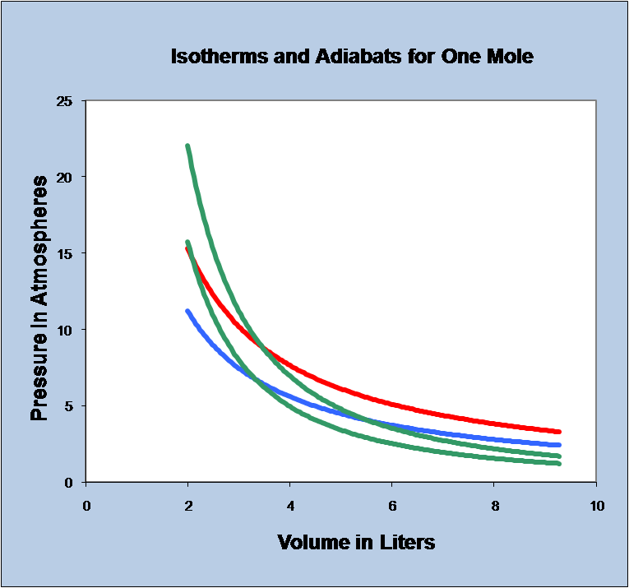
Back to the Carnot Cycle…
But this time think of it as showing two different routes from a to c: abc and adc.
We know that the total change in a state variable, P, V or T, from a to c doesn’t depend on which path we take.
BUT the total heat flow into the gas DOES depend on path! The “amount of heat” in the gas is meaningless.
a
b
d
c

Slide 4
Back to the Carnot Cycle…
However, the heat input Q_{H} along abc is related to the heat input Q_{L} along adc:
Clausius defined “entropy” by: the entropy change along a half Carnot cycle is
This doesn’t depend on path!
a
b
d
c

Slide 5
Different Reversible Paths from a to c
Now suppose we follow the path aefgc, where efgd is a little Carnot cycle. Then the entropy change efg is the same as edg, so the total entropy change along this path from a to c is the same as adc.
By adding lots of little Carnot zigzags like this, we can get from any reversible path from a to c to any other reversible path, and define the entropy change from a to c unambiguously as:
z
a
b
e
f
d
g
c

Slide 6
What about Irreversible Paths?
Suppose we have an insulated container with a partition down the middle, ideal gas on one side, vacuum on the other.
The partition is suddenly removed—gas fills the whole space. What happens to the gas temperature?
It increases.
It decreases.
It stays the same.
Z
gas
vacuum
partition

Slide 7
What (P, V) Path Does the Gas Follow?
The initial state is P, V, T, say, and some time later P/2, 2V, T.
BUT in getting from one to the other, it does not follow a path in the (P, V) plane! Obviously, P varies within the container:
However, the entropy difference between the initial and final states is well defined—remember, it’s defined by a reversible path...
C
gas
vacuum

Slide 8
Reversible Path from V to 2V at Constant T
We could get from P, V to P/2, 2V reversibly along an isotherm, replacing that partition with a slow moving piston—but now we must supply heat, since the gas does work. From an earlier lecture, work done in isothermal expansion is , so for N molecules:
x

Slide 9
Entropy Measures Occupied Space
Each time we double the volume V a gas can move around in, at constant T, the entropy per molecule increases by kln2: entropy is apparently a measure of available space for the molecule to wander around in.
But what if we double T at constant V? That certainly increases entropy—we had to supply heat, but the molecule’s still stuck in V.
So what does that have to do with the space a molecule has to move around in?

Slide 10
Microscopic States of a Gas
Imagine you wanted to know everything about a gas at one instant: what would that mean?
First, you’d need the position of every molecule: you could draw a picture with dots indicating where each one was.
But that’s not all: you need to know all the velocities as well!
You could put lots of dots in a “velocity space”…
v_{z}
v_{y}
v_{x}
One dot in this 3D space would represent the velocity of one molecule at an instant.

Slide 11
Molecular Velocities
Z
Recall the rms molecular velocity is given by
The actual velocity distribution is pretty complicated, but is well represented by this fuzzy blue sphere of radius proportional to v_{rms}, meaning T.
So, with lots of collisions, a molecule wanders around a volume of velocity space  T ^{3/2}, the volume of this sphere.
v_{z}
v_{y}
v_{x}

Slide 12
How Does Entropy Vary with Temperature at Constant Volume?
Let’s heat an ideal monatomic gas from T to 2T at constant V.
Remember when we doubled the volume of space, each molecule had kln2 more entropy.
Doubling the temperature has increased the volume of velocity space by the volume of the sphere having radius T: this volume has increased by a factor 2^{3/2}: this gives the right ΔS!

Slide 13
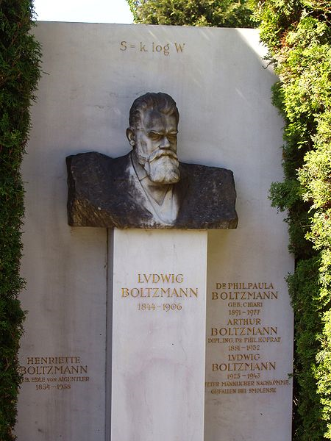
S = klnW
Bottom Line: the entropy per molecule is k times the log of the total amount of space— ordinary space and “velocity space” together—the molecule is free to wander around in. This combination is called “phase space”, written W.
This was Boltzmann’s great achievement, and his epitaph.

Slide 14
Entropy and Heat Flow
Heat flow between objects at different temperatures invariably causes entropy to rise.
Suppose heat ΔQ flows from temperature T₁ to T₂ (T₁ > T₂, of course) then
Unless we are trying to heat the cooler object, this is wasting heat which could have been used to drive a heat engine between the two temperatures.

Slide 15
Entropy and Heat Flow
No energy is lost in this heat flow—it’s just spread around more evenly. The entropy increase implies that the energy is “taking up more space”.
This means, though, that the energy is less available to do work. We can extract useful work from temperature differences—having the energy concentrated in part of the system.

Slide 16
Entropy and Disorder
Suppose we have a partitioned box with red molecules on one side, green on the other.
We remove the partition and let them mix—clearly this is more disordered.
Think of tossing a coin for each molecule to decide which half to put it in. What are the chances of getting the top arrangement?
x

Slide 17
Entropy and Disorder
What are the chances of getting the top arrangement?
For 60 molecules, 1 in 2⁶⁰, or about one in a billion billion. It’s like the random walk: the chance of every step being in the same direction. And, just as most random walks end near where they start, meaning roughly equal numbers of steps each way, most molecule arrangements have roughly equal numbers each side.
x

Slide 18
Entropy and Disorder
The entropy can be thought of as the ln of the number of arrangements of molecules corresponding to the observed macroscopic state. This is the amount of “phase space” for that state. There’s only one left-right arrangement giving the upper picture, a multitude look like the bottom, with roughly equal mixing.
So, the lower picture is the higher entropy.
x

Slide 19
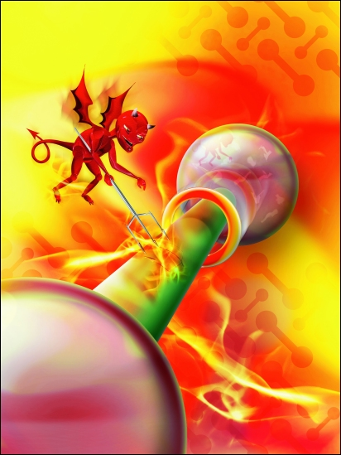
Maxwell’s Demon
It occurred to Maxwell that a tiny creature he called his demon should be able to decrease entropy, and violate the Second Law, if it were quick enough and could see molecules …

Slide 20
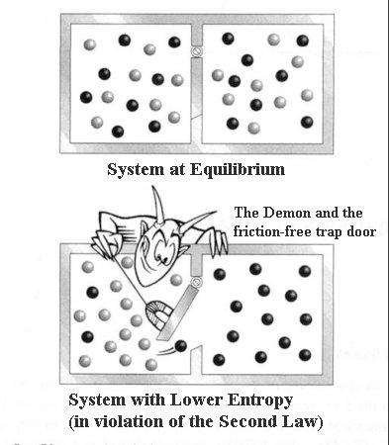
Maxwell’s Demon
The idea is that the demon could open and close a little trap door fast enough as the molecules bounced around that they could be sorted out as shown…
What’s wrong with this argument?

Slide 21
Clicker Question
What’s wrong (if anything) with Maxwell’s argument that the Second law could be violated by a nimble enough demon?
Nothing—it could happen.
Nothing could be miniaturized to the extent needed.
The sorting machine (aka demon) would itself generate entropy doing this, which would likely save the Second Law.

Slide 22
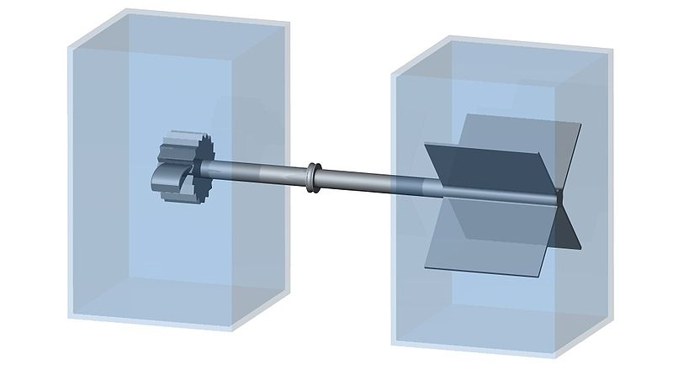
Feynman’s Ratchet
A tiny paddle is hit randomly by molecules flying around, but can only turn one way—there’s a ratchet wheel.
So, maybe the random heat energy of the flying molecules can be harnessed as useful mechanical energy?

Slide 23
Feynman’s Ratchet
It works for the first few molecules, but then the ratchet itself gets hot, jiggles around, and the wheel is equally likely to move either way.
Bottom Line: no machine can be devised, even of molecular size, to just extract heat energy, cooling the gas, and generate work.

