Slide 1
The Second Law of Thermodynamics:
Heat Engines
Physics 1425 Lecture 35
Michael Fowler, UVa

Slide 2
The First Law of Thermodynamics
In any process, total energy is always conserved.
Once it was fully realized that heat is just another form of energy, it was established with many experiments on an immense variety of processes, mechanical, electrical, chemical, nuclear, etc., that in all processes in nature total energy doesn’t change.
So only processes that conserve total energy are allowed, but that’s not the whole story …

Slide 3
The Second Law of Thermodynamics
Extensive experimentation and observation have established that some total energy conserving processes actually never occur in nature (or in the lab):
Heat energy will never flow by itself from a cold body to a hot body.
There is no way to devise a cyclic engine that takes heat from a reservoir, does work, and has no waste heat left over.
Both the above are Statements of the Second Law.
Z

Slide 4
Heat, Work and Waste in a Heat Engine
A typical piston heat engine works by supplying heat to a gas, which then expands, pushing the piston and doing work.
For the engine’s next cycle, the gas must be compressed back to the original volume, and while it’s being compressed it must be cooler, otherwise all the work it did expanding would be needed. To keep it cool, it must shed heat—this is the waste heat, which is unavoidable.

Slide 5
Efficiency of a Heat Engine
The standard model is an engine taking heat Q_{H} (> 0) from a “hot reservoir” at constant temperature T_{H}, dumping heat Q_{L} (> 0) in a “cold reservoir” at T_{L}, and delivering work W, so
Q_{H} = Q_{L} + W.
The efficiency e is defined as
e = W/Q_{H},
the fraction of the heat energy input delivered as work.
z
T_{H}
Q_{H}
engine
W
Q_{L}
T_{L}

Slide 6
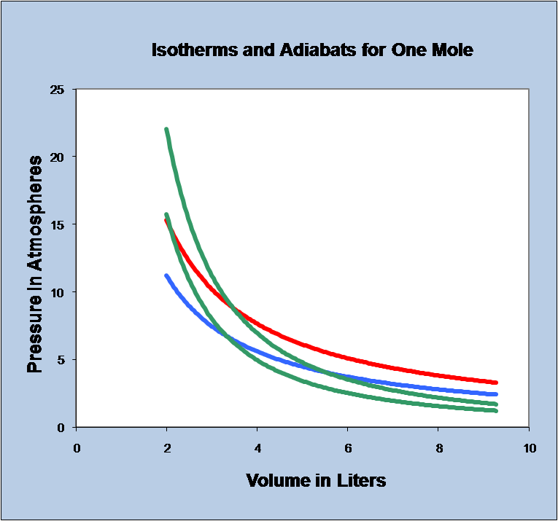
The Carnot Cycle
This is a model heat engine, using an ideal gas. The cycle has four “legs”: along ab, an isothermal, the gas takes in heat Q_{H} at T_{H}. bc is adiabatic expansion. The gas is delivering work along abc.
cd is isothermal compression, losing heat Q_{L} at T_{L}, da is adiabatic compression.
The work delivered equals the area inside the curve.
a
b
d
c
Animation!

Slide 7
Carnot Efficiency
Using the equations we have discussed for isotherms and adiabats, it can be proved that the efficiency of a perfect Carnot engine (no friction, slow motion to maintain thermal equilibrium at all times) depends only on the temperatures of the two reservoirs:
The derivation is straightforward algebra, and can be found here.

Slide 8
Reversibility: a Carnot Refrigerator
Since each leg of the Carnot cycle is reversible, the whole cycle can be reversed to give a refrigerator: work is put in to take heat from a cold reservoir and deliver it to a hotter one.
Q_{H} = Q_{L} + W.
The coefficient of performance is defined as
COP = Q_{L}/W.
z
T_{H}
Q_{H}
fridge
W
Q_{L}
T_{L}

Slide 9
No Engine Can Beat Carnot for Efficiency
If an engine could be devised taking Q_{H} from the hot reservoir at T_{H} and delivering W + Δ of work, depositing Q_{L} – Δ at T_{L}, where W, Q_{L} are the Carnot values, then it could be hooked to a Carnot refrigerator, which would use W of its output to take Q_{L} from the lower reservoir and deposit Q_{H} in the upper.
The net result of the coupled engine-refrigerator is to take heat Δ from the lower reservoir and deliver it as work, contradicting the Second Law.

Slide 10
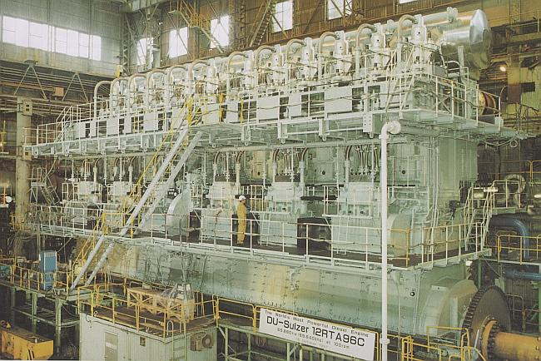
One Big Diesel Engine…
This 12 cylinder Diesel engine is 50% efficient (about twice an automobile efficiency), runs at 100 rpm, producing 100,000 hp.
It weighs about 2,000 tons.
Powers a container ship.

Slide 11
ConcepTest 20.1 Heat Engine
The heat engine below is:
1) a reversible (Carnot) heat engine
2) an irreversible heat engine
3) a hoax
4) none of the above
Notes:
Click to add notes

Slide 12
ConcepTest 20.1 Heat Engine
The heat engine below is:
1) a reversible (Carnot) heat engine
2) an irreversible heat engine
3) a hoax
4) none of the above
Carnot e = 1 − T_{C}/T_{H} = 1 − 270/600 = 0.55.
But by definition e = 1 − Q_{L}/Q_{H}
= 1 − 4000/8000 = 0.5, smaller
than Carnot e, thus irreversible.
Follow-up: What would you need to change to make it a Carnot engine?

