Slide 1
One-Dimensional Motion: Displacement, Velocity, Acceleration
Physics 1425 Lecture 2
Michael Fowler, UVa.

Slide 2
Today’s Topics
The previous lecture covered measurement, units, accuracy, significant figures, estimation.
Today we’ll focus on motion along a straight line: distance and displacement, average and instantaneous velocity and acceleration, the importance of sign.
We’ll discuss the important constant acceleration formulas.

Slide 3
Kinematics: Describing Motion
Kinematics describes quantitatively how a body moves through space.
We’ll begin by treating the body as rigid and non-rotating, so we can fully describe the motion by following its center.
Dynamics accounts for the observed motion in terms of forces, etc. We’ll get to that later.

Slide 4
Measuring Motion: a Frame of Reference
Frame of reference:
To measure motion, we must first measure position.
We measure position relative to some fixed point O, called the origin.
We give the ball’s location as (x, y, z): we reach it from O by moving x meters along the x-axis, followed by y parallel to the y-axis and finally z parallel to the z-axis.
z
(x, y, z)
y
O
x
The frame can be envisioned as three meter sticks at right angles to each other, like the beginning of the frame of a structure.

Slide 5
One-Dimensional Motion: Distance Traveled and Displacement
The frame of reference in one dimension is just a line!
Think of a straight road.
Driving a car, the distance traveled is what the odometer reads.
The displacement is the difference x₂ – x₁ from where you started (x₁) to where you finished (x₂).
They’re only the same if you only go in one direction!
-1
O
1
x
This time we’ve made explicit that the x-axis also extends in the negative direction, so we can label all possible positions.

Slide 6
Distance and Displacement
Take I-64 as straight, count Richmond direction as positive.
Drive to Richmond: distance = 120 km (approx), displacement = 120 km.
Drive to Richmond and half way back:
Distance = 180 km, displacement = 60 km.
Drive to closest Skyline Drive entrance:
Distance = 35 km, displacement = -35 km.

Slide 7
Displacement is a Vector!
A displacement along a straight line has magnitude and direction: + or – . That means it’s a vector.
If the displacement Δx = x₂ – x₁, magnitude is written
|Δx| = |x₂ – x₁|.
Direction is indicated by attaching an arrowhead
to the displacement :
Charlottesville to Richmond
Charlottesville to Skyline Drive

Slide 8
ConcepTest 2.1 Walking the Dog
You and your dog go for a walk to the park. On the way, your dog takes many side trips to chase squirrels or examine fire hydrants. When you arrive at the park, do you and your dog have the same displacement?
1) yes
2) no
Notes:
Click to add notes

Slide 9
ConcepTest 2.1 Walking the Dog
You and your dog go for a walk to the park. On the way, your dog takes many side trips to chase squirrels or examine fire hydrants. When you arrive at the park, do you and your dog have the same displacement?
1) yes
2) no
Yes, you have the same displacement. Because you and your dog had the same initial position and the same final position, then you have (by definition) the same displacement.
Follow-up: have you and your dog traveled the same distance?

Slide 10
ConcepTest 2.2 Displacement
Does the displacement of an object depend on the specific location of the origin of the coordinate system?
1) yes
2) no
3) it depends on the coordinate system
Notes:
Click to add notes

Slide 11
ConcepTest 2.2 Displacement
Does the displacement of an object depend on the specific location of the origin of the coordinate system?
1) yes
2) no
3) it depends on the coordinate system
Because the displacement is the difference between two coordinates, the origin does not matter.
10
20
30
40
50
30
40
50
60
70

Slide 12
Average Speed and Average Velocity
Average speed = distance car driven/time taken.
Average velocity = displacement/time taken
so average velocity is a vector! It can be negative.
Formula for average velocity:
Example: round trip to Richmond.
Average speed = 60 mph ≈ 27 m/sec.
Average velocity = zero!

Slide 13
Instantaneous Velocity
That’s the velocity at one moment of time: car speedometer gives instantaneous speed.
To find this, need to find car’s displacement in a very short time interval (to minimize speed variation).
Mathematically, we write:
This “lim” just means taking a succession of shorter and shorter time intervals at the moment in time.

Slide 14
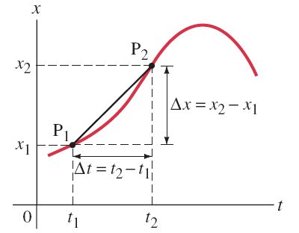
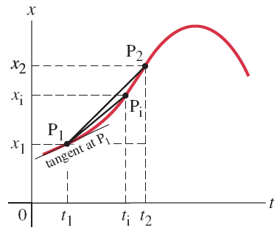
2-3 Instantaneous Velocity
On a graph of a particle’s position vs. time, the instantaneous velocity is the slope of the tangent to the curve at that point.
Notes:
Figure 2-10. Caption: Graph of a particle’s position x vs. time .The slope of the straight line P₁P₂ represents the average velocity of the particle during the time interval Δt = t₂ – t₁.
Figure 2-11. Caption: Same position vs. time curve as in Fig. 2–10, but note that the average velocity over the time interval t_{i} – t₁ (which is the slope of P₁P_{i}) is less than the average velocity over the time interval t₂ – t₁. The slope of the thin line tangent to the curve at point P₁ equals the instantaneous velocity at time t₁.

Slide 15
Average Trip Speed You drive 60 miles at 60 mph, then 60 miles at 30 mph. What was your average speed?
40 mph
45 mph
47.5 mph

Slide 16
Average Trip Speed You drive 60 miles at 60 mph, then 60 miles at 30 mph. What was your average speed?
40 mph
45 mph
47.5 mph
Total distance = 120 miles, time taken = 3 hours.

Slide 17
Acceleration
Average acceleration = velocity change/time taken
Notice that acceleration relates to change in velocity exactly as velocity relates to change in displacement.
Velocity is a vector, so acceleration is a vector.
Taking displacement towards Richmond as positive:
Slowing down while driving to Richmond: negative acceleration.
Speeding up driving to Skyline Drive: also negative acceleration!

Slide 18
Instantaneous Acceleration
This is just like the definition of instantaneous velocity:
The instantaneous acceleration
The acceleration at time t₁ is the
slope of the velocity graph v(t)
at that time.
v(t)
O
t₁
t

Slide 19
Our Units for One-Dimensional Motion
Displacement: meters (can be positive or negative)
Velocity = rate of change of displacement, units:
Meters per second, written m/s or m.sec⁻¹.
Acceleration = rate of change of velocity, units:
Meters per second per second, written m/s² or m.sec⁻².

Slide 20
Constant Acceleration
Constant acceleration means the rate of change of velocity is constant.
The solution to this equation is
Check with an example: a car traveling at 10 m/s accelerates steadily at 2 m/s². How fast is it going after 2 secs? After 4 secs?

Slide 21
Distance Moved at Constant Acceleration
At constant acceleration,
The solution of this equation is
Here x₀ is the beginning position, v₀ the beginning velocity, a the constant acceleration.
Exercise: check this by finding dx/dt.

Slide 22
More about Constant Acceleration…
At constant acceleration,
the graph of velocity as a
function of time v(t) = v₀ + at
is a straight line:
If v = v₀ at t = 0, and v = v₁ at t = t₁, the average velocity over the time interval 0 to t₁ is
IMPORTANT! This formula is unlikely to be correct at nonconstant acceleration.
v₁
v₀
v(t)
0
t₁

Slide 23
Constant Acceleration Formulas
These formulas are worth memorizing: the last one is simply derived by eliminating t between the first two.

Slide 24
Problems from the Chapter
37. (II) A car slows down uniformly from a speed of 18.0 m/s to rest in 5.00 s. How far did it travel in that time?
38. (II) In coming to a stop, a car leaves skid marks 85 m long on the highway. Assuming a deceleration of 4.00 m/s² estimate the speed of the car just before braking.

Slide 25
The picture below shows time (4.56 secs) and speed (321 mph) for a standing start quarter mile at Indianapolis. Assuming constant acceleration, what was the approximate horizontal g-force on the driver?
0.3g
0.8g
1.5g
3g
5g

