Slide 1
Light II
Physics 2415 Lecture 32
Michael Fowler, UVa

Slide 2
Today’s Topics
Huygens’ principle and refraction
Snell’s law and applications
Dispersion
Total internal reflection

Slide 3
Huygens’ Principle
Newton’s contemporary Christian Huygens believed light to be a wave, and pictured its propagation as follows: at any instant, the wave front has reached a certain line or curve. From every point on this wave front, a circular wavelet goes out (we show one), the envelope of all these wavelets is the new wave front.
.
Huygens’ picture of circular propagation from a point source.
Propagation of a plane wave front.

Slide 4
Huygens’ Principle and Refraction
Assume a beam of light is traveling through air, and at some instant the wave front is at AB, the beam is entering the glass, corner A first.
If the speed of light is c in air, v in the glass, by the time the wavelet centered at B has reached D, that centered at A has only reached C, the wave front has turned through an angle.
.
B
Air
A
Glass
D
C
The wave front AB is perpendicular to the ray’s incoming direction, CD to the outgoing—hence angle equalities.

Slide 5
Snell’s Law
If the speed of light is c in air, v in the glass, by the time the wavelet centered at B has reached D, that centered at A has only reached C, so AC/v = BD/c.
From triangle ABD, BD = ADsinθ₁.
From triangle ACD, AC = ADsinθ₂.
Hence
.
B
Air
A
Glass
D
C
The wave front AB is perpendicular to the ray’s incoming direction, CD to the outgoing—hence angle equalities.

Slide 6
The Refractive Index
The speed of light in a vacuum is c, very close to 3x10⁸ m/sec.
In all other media, the speed of light is less.
The refractive index n of a material is the ratio of c and the speed v in that material:
Snell’s law for light going from one material to another:

Slide 7
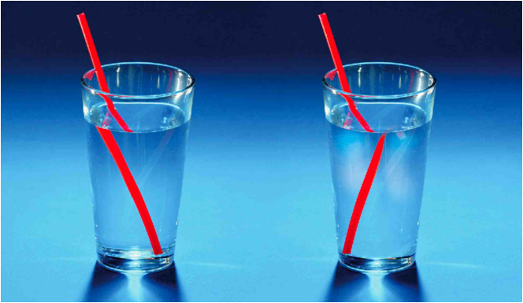
Negative Refractive Index
.
Is this real or is it Photoshop?

Slide 8
Negative Refractive Index?
OK, it’s Photoshop—but from a recent article in Nature on metamaterials (materials artificially constructed at the nanoscale) that do have negative refractive index, and many possible uses, from optical data storage to cloaks of invisibility…see the link for more details.

Slide 9
Moving Light Sideways
Looking at an angle through thick glass, things appear shifted sideways.
(If we had some negative refractive material, we could direct light around something.)
.
Air
Glass
Air

Slide 10
That water is deeper than it looks!
.
Light rays from an object under water will appear from the air above to originate at a shallower depth.
The dotted lines, extensions of the rays in air, locate the apparent position at depth d´.
Air
Water
d´
d

Slide 11
Just how deep?
We’ll just look at half the ray diagram.
The rays originate under water, so we use for the ray in the water, for the ray in air and its apparent extension into the water:
Looking straight down, both these angles are small, so, from the diagram:
.
Air
x
Water
d´
d
Apparent depth is about 75% of true depth.

Slide 12
Clicker Question
If you look towards the middle of a pool while standing on the edge does the water there look
Deeper
Shallower
The same
as if you were looking straight down from above the middle?

Slide 13
Clicker Question
If you look towards the middle of a pool while standing on the edge does the water there look
Deeper
Shallower
The same
as if you were looking straight down from above the middle?

Slide 14
Dispersion of Light
The refractive index of a material is a function of light wavelength:

Slide 15
Refractive Index n for Water and Glasses
Water
Over the visible range (400 – 700nm), the refractive index varies about 2% for water, around 5% for glasses.
The prism also passes some infrared and ultraviolet.

Slide 16
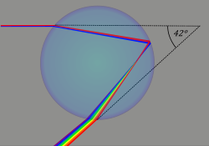
Rainbows!
Instead of a prism, the light is refracted through drops of water.
The fainter secondary rainbow corresponds to a double internal reflection, which reverses the order of colors.

Slide 17
Total Internal Reflection
For a ray traveling from glass (refractive index n) to air (refractive index 1), some fraction will be reflected back at the interface.
But if the angle of incidence is increased to approach the value where , must approach 90° from Snell’s law. For greater than that value, no light can escape—it’s all reflected.
.

Slide 18
Using Total Internal Reflection
Light shone along a solid transparent cylinder is trapped in the cylinder provided its angle of incidence is greater than the critical angle.
This is, essentially, the principle used to transmit light in optical fibers.

Slide 19
Clicker Question
If a glass cylinder is under water, can a light signal still bounce along inside it like this?
No, it would always get out.
Yes, but the distance between reflections would have to be greater.
Same but smaller.

Slide 20
Clicker Answer
If a glass cylinder is under water, can a light signal still bounce along inside it like this?
No, it would always get out.
Yes, but the distance between reflections would have to be greater.
Same but smaller.
For total internal reflection, we now have
and .

Slide 21
Frustrated Total Internal Reflection
A full solution of Maxwell’s equations reveals that where the beam is totally internally reflected, in fact there is an electromagnetic wave in the air, but it dies away in a distance of order the wavelength on going from the surface. However, if another substance is brought close, this wave can be absorbed and/or scattered back, and detected. This is used for fingerprint reading and some touch technology.

