Slide 1
Waves II
Physics 2415 Lecture 26
Michael Fowler, UVa

Slide 2
Today’s Topics
The wave equation
Energy and power of waves
Superposition
Standing waves as sums of traveling waves
Fourier series

Slide 3
Harmonic Waves
A simple harmonic wave has sinusoidal form:
For a string along the x-axis, this is local displacement in y-direction at some instant.
For a sound wave traveling in the x-direction, this is local x-displacement at some instant.
Amplitude A
Wavelength λ

Slide 4
Traveling Wave
Experimentally, a pulse traveling down a string under tension maintains its shape:
Mathematically, this means the perpendicular displacement y stays the same function of x, but with an origin moving at velocity v:
vt

Slide 5
Traveling Harmonic Wave
A sine wave of wavelength λ, amplitude A, traveling at velocity v has displacement
y
0
x
vt
λ

Slide 6
Harmonic Wave Notation
A sine wave of wavelength λ, amplitude A, traveling at velocity v has displacement
This is usually written , where the “wave number” and .
As the wave is passing, a single particle of string has simple harmonic motion with frequency ω radians/sec, or f = ω/2π Hz. Note that v = λf

Slide 7
The Wave Equation
The wave equation is just Newton’s law F = ma applied to a little bit of the vibrating string:
The tiny length of string shown in red has length m = μdx, is accelerating in the y-direction with acceleration , and the force F is the sum of the tensions at the two ends of the bit of string, which don’t cancel because they’re not parallel. Animation!

Slide 8
The Wave Equation
The y-direction component of the tension T at the front end of the string is just T multiplied by the slope (for small amplitudes), .
At the back end, T points backwards, so the downward component is .
The total y-direction force is therefore

Slide 9
Wave Equation
We’re ready to write F = ma for that bit of string:
m = μdx, .
Putting it all together:
Since this is nothing but Newton’s second law, it must be true for any wave on a string.

Slide 10
Traveling Wave Equation
Recall that from observation a traveling wave has the form .
From the chain rule, for that function
Comparing this with the wave equation, we see that
This proves that .

Slide 11
Harmonic Wave Energy
Writing the wave where remember it’s clear that at any fixed point x a bit of string dx is oscillating up and down in simple harmonic motion with amplitude A and frequency f = ω/2π Hz.
The energy of that bit dx is all kinetic when y = 0, ( kx = ωt), the y-velocity at that instant is
so the total energy in dx is

Slide 12
Harmonic Wave Energy
The total energy in dx is
so in length L the wave energy is .
Imagine now a group of waves, choose length v, moving to the right at speed v (passes you in just one second!):
The power delivered by the waves is the energy passing a fixed point per second—that is
v m/sec
v

Slide 13
The Wave Equation and Superposition
If you have two solutions to the wave equation, y = f(x,t) and y = g(x,t), then y = f + g is also a solution to the wave equation!
This can be checked with the actual equation:
Differential equations with this property are called “linear”. It means you can build up any shape wave from harmonic waves.

Slide 14
A Wave Hits a Wall…
When a wave hits a wall, the energy and wave form are reflected.
What does this look like? Let’s take the case of a wave on a string, the string fixed at one end.
Now think about a harmonic wave hitting a wall!

Slide 15
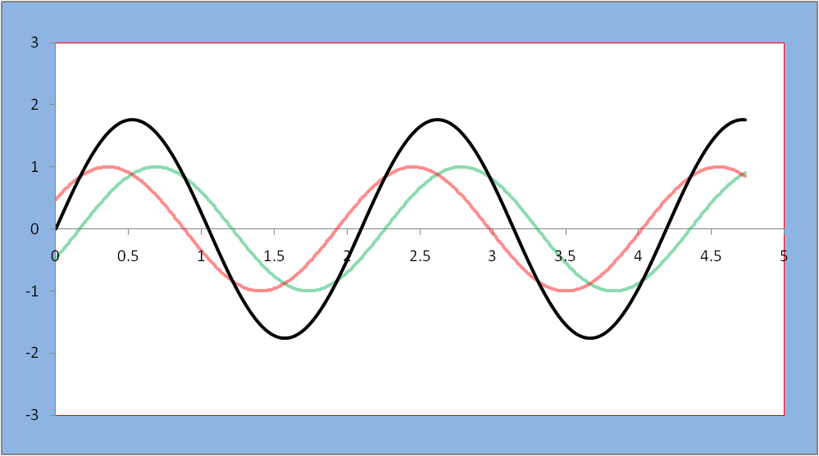
Harmonic Wave Addition
Two harmonic waves of the same wavelength and amplitude, but moving in opposite directions, add to give a standing wave.
Notice the standing wave also satisfies λf = v, even though it’s not traveling!

Slide 16
Standing Wave Formula
To add two traveling waves of equal amplitude and wavelength moving in opposite directions, we use the trig formula for addition of sines:
Applying this,
Allowed values of k are given by
where  is the string length.

Slide 17
Harmonic Wave on String
The amplitude must always be zero at the ends of the string. From λv = f, the lowest frequency note (the fundamental, or first harmonic) has the longest allowed wavelength: λ = 2.
The second harmonic has λ = :

Slide 18
Clicker Question
For standing waves of equal amplitude on identical strings at the same tension, one string vibrating in the first harmonic mode, the other the second harmonic, the energy in the second harmonic string is:
A. twice that in the first harmonic string
B. four times…
C. equal to…

Slide 19
Clicker Answer
For standing waves of equal amplitude on identical strings at the same tension, one string vibrating in the first harmonic mode, the other the second harmonic, the energy in the second harmonic string is:
A. twice that in the first harmonic string
B. four times…
C. equal to…

Slide 20
Nodes and Antinodes
x = 0
x = 
antinode
node
The standing wave has form
For a pure note on a string with fixed ends,
At a node, the string never moves:

Slide 21
Clicker Question
The tension in a guitar string of fixed length is increased by 10%. How does that change the wavelength of the second harmonic?
A. It increases by 10%
B. It increases by about 5%
C. It decreases by 10%
D. it decreases by about 5%
It stays the same.

Slide 22
Clicker Answer
The tension in a guitar string of fixed length is increased by 10%. How does that change the wavelength of the second harmonic?
A. It increases by 10%
B. It increases by about 5%
C. It decreases by 10%
D. it decreases by about 5%
It stays the same: it’s just the length of the string!

Slide 23
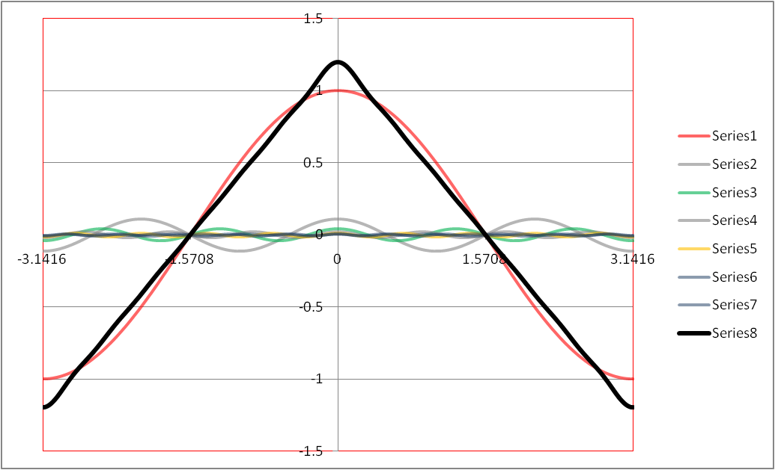
Fourier Series
We can also build up any type of periodic wave by adding harmonic waves with the right amplitudes—this is called “Fourier analysis”: in music, it’s building up a complex note from its harmonics: here’s a triangle (formed by pulling an instrument string up at the midpoint then letting go?).

Slide 24
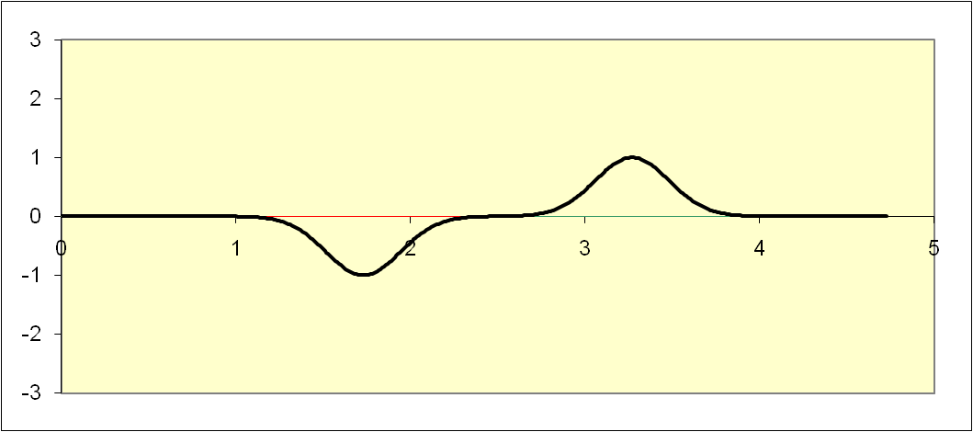
Pulse Encounter
It’s worth seeing how two pulses traveling in opposite directions pass each other:

