Slide 1
AC Circuits I
Physics 2415 Lecture 22
Michael Fowler, UVa

Slide 2
Today’s Topics
General form of Faraday’s Law
Self-Inductance
Mutual Inductance
Energy in a Magnetic Field

Slide 3
Faraday’s Law: General Form
A changing magnetic flux through a loop generates an emf around the loop which will drive a current. The emf can be written:
In fact, this electric field is there even without the wire: if an electron is circling in a magnetic field, and the field strength is increased, the electron accelerates, driven by the circling electric field—the basis of the betatron.

Slide 4
The Betatron
If an electron is circling in a magnetic field, and the magnetic field intensity is increased, from Faraday’s law there will be circling lines of electric field which accelerate the electron. It is easy to design the field so that the electron circles at constant radius—electrons can attain 99.9% of the speed of light this way.
.
magnetic field perp into screen
A betatron was used as a trigger in an early nuclear bomb.

Slide 5
Clicker Question
V
You have a single loop of superconducting wire, with a current circulating. The current will go on forever if you keep it cold.
But you let it warm up: resistance sets in.
The current dies away, and therefore so does the magnetic field it produced.
Does this decaying magnetic field induce an emf in the loop itself? A: Yes B: No.
(Assume there are no other loops, or magnets, etc., anywhere close.)

Slide 6
Clicker Answer
V
Does this decaying magnetic field induce an emf in the loop itself? A: Yes B: No.
Yes it does! The induced emf will be such as to produce some magnetic field to replace that which is disappearing—that is, in this case it will generate field going in through the loop, so the current will be as shown.
You could also say the induced emf is such as to oppose the change in current.
This is called “self-inductance”.

Slide 7
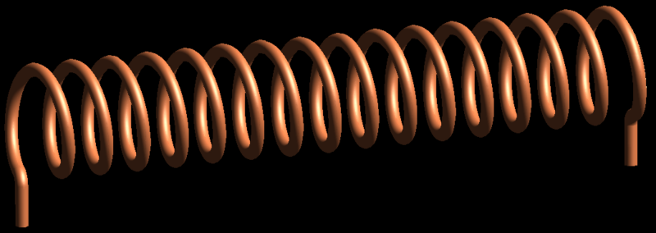
“Self-Inductance” of a Solenoid
What emf E is generated in a solenoid with N turns, area A, for a rate of change of current dI/dt?
Recall from Ampère’s law that B = μ₀nI, so Φ_{B} = μ₀NIA/ℓ.
This flux goes through all N turns, so the total flux is NΦ_{B}.
Hence emf from changing I is:
.
N turns total in length ℓ: N/ℓ = n turns per meter.

Slide 8
Definition of Self-Inductance
For any shape conductor, when the current changes there is an induced emf E opposing the change, and E is proportional to the rate of change of current.
The self-inductance L is defined by:
and symbolized by:
Unit: for E in volts, I in amps L is in henrys (H).

Slide 9
Mutual Inductance
We’ve already met mutual inductance: when the current I₁ in coil 1 changes, it gives rise to an emf E ₂ in coil 2.
The mutual inductance M₂₁ is defined by:
where is the magnetic flux through a single loop of coil 2 from current I₁ in coil 1.
.
Coil 1: N₁ loops
Coil 2: N₂ loops
Coil 2
Coil 1

Slide 10
Mutual Inductance Symmetry
Suppose we have two coils close to each other. A changing current in coil 1 gives an emf in coil 2:
Evidently we will also find:
Remarkably, it turns out that
M₁₂ = M₂₁
This is by no means obvious, and in fact quite difficult to prove.

Slide 11
Mutual Inductance and Self Inductance
For a system of two coils, such as a transformer, the mutual inductance is written as M.
Remember that for such a system, emf in one coil will be generated by changing currents in both coils, as well as possible emf supplied from outside.

Slide 12
Energy Stored in an Inductance
If an increasing current I is flowing through an inductance L, the emf LdI/dt is opposing the current, so the source supplying the current is doing work at a rate ILdI/dt, so to raise the current from zero to I takes total work
This energy is stored in the inductor exactly as is stored in a capacitor.

Slide 13
Energy Storage in a Solenoid
Recall from Ampère’s law that B = μ₀nI, where n = N/ℓ.
We found (ignoring end effects) the inductance
Therefore
an energy density inside.
.

Slide 14
Energy is Stored in Fields!
When a capacitor is charged, an electric field is created.
The capacitor’s energy is stored in the field with energy density .
When a current flows through an inductor, a magnetic field is created.
The inductor’s energy is stored in the field with energy density .

Slide 15
Mutual Inductance and Self Inductance
For a system of two coils, such as a transformer, the mutual inductance is written as M.
Remember that for such a system, emf in one coil will be generated by changing currents in both coils:

Slide 16
Clicker Question
Two circular loops of wire, one small and one large, lie in a plane, and have the same center.
A current of 1 amp in the large loop generates a magnetic field having total flux Φ_{S} through the small loop.
1 amp in the small loop gives total flux Φ_{L} through the large loop.
Φ_{S} > Φ_{L}
Φ_{S} < Φ_{L}
Φ_{S} = Φ_{L}

Slide 17
Clicker Question
Two circular loops of wire, one small and one large, lie in a plane, and have the same center.
A current of 1 amp in the large loop generates a magnetic field having total flux Φ_{S} through the small loop.
1 amp in the small loop gives total flux Φ_{L} through the large loop.
Φ_{S} > Φ_{L}
Φ_{S} < Φ_{L}
Φ_{S} = Φ_{L} M₁₂ = M₂₁

Slide 18
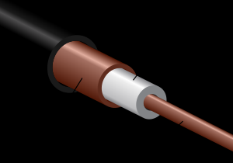
Coaxial Cable Inductance
In a coaxial cable, the current goes one way in the central copper rod, the opposite way in the enclosing copper pipe.
To find the inductance per unit length, remember the energy stored is in the magnetic field.
.
I
Coaxial cables carry high frequency ac, such as TV signals. These currents flow on the surfaces of the conductors.

Slide 19
Coaxial Cable Inductance
To find the inductance per unit length, remember the energy stored is in the magnetic field.
From Ampere’s Law the magnetic field strength at radius r (entirely from the inner current) is
.
I
r

Slide 20
Coaxial Cable Inductance
The energy stored is in the magnetic field, energy density .
From Ampere’s Law,
so the energy/meter
from which the inductance/m
.
I
r

