Slide 1
Magnetism II
Physics 2415 Lecture 15
Michael Fowler, UVa

Slide 2
Today’s Topics
Force on a charged particle moving in a magnetic field
Path of a charged particle moving in a magnetic field
Torque on a current loop in a magnetic field, magnetic dipole moment

Slide 3
Earth’s Magnetic Field
is approximately that of a bar magnet almost (but not quite) aligned with the axis of rotation.
The S pole is under the Arctic—so a compass N pole points appropriately.
At the Earth’s surface, the magnetic field is approximately horizontal only near the equator. The inclination to the horizontal is the dip angle: 90° at the magnetic poles.

Slide 4
Force on Straight Wire Carrying Current in Constant Magnetic Field
It is well established experimentally that
is true for any angle between the wire increment and the constant field direction.
In particular, a wire parallel to the field will feel zero force.
This equation fixes the unit of magnetic field: for F in Newtons, I amps, B is in Teslas.

Slide 5
Force on an Electric Charge Moving in a Magnetic Field
We’ve seen that the force on an element of current in a wire in a magnetic field is:
The current I is a line density λ C/m of charge moving at speed v, where I = λv. Let’s denote the total charge in a particular by Q = λdℓ.
Then Qv = λvdℓ = Idℓ, and the force on the current element is seen to be a force on this moving charge, .

Slide 6
Clicker Question
A charged particle moving through a magnetic field feels a force .
The rate at which the magnetic field does work on the particle depends on:
Only the magnetic field strength and the charge
It depends also on the velocity and angle
None of the above: the work done by the magnetic field is always zero.

Slide 7
Clicker Answer
A charged particle moving through a magnetic field feels a force .
The rate at which the magnetic field does work on the particle is zero.
In a time dt, the particle moves and the work done
since
The force is always perpendicular to the direction of motion, so does no work.

Slide 8
Proton in a Cyclotron
A proton in a uniform magnetic field, with initial velocity perpendicular to the field, will circle at constant speed in a plane perpendicular to the field.
The equation of motion is
.
magnetic field perp into screen

Slide 9
Proton in a Cyclotron
The equation of motion is
from which the time of one revolution
and this is independent of the radius of the orbit!
This independence made the cyclotron accelerator possible.
.
magn field perp into screen

Slide 10
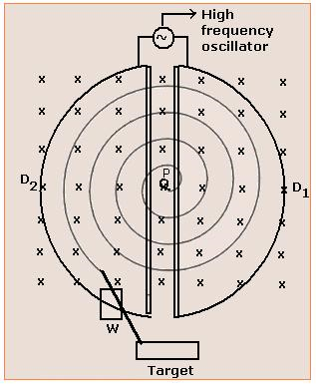
Proton in a Cyclotron
The two “D”s are hollow D-shaped metal boxes, open along the straight part.
The circling protons go back and forth.
The oscillator alternates the relative voltages of the D’s, so as a proton goes from one to the other it is attracted and accelerates, going into a larger, faster circle—but with the same period—each time.
.
If the proton reaches relativistic speeds, its mass increases and the circling time changes.

Slide 11
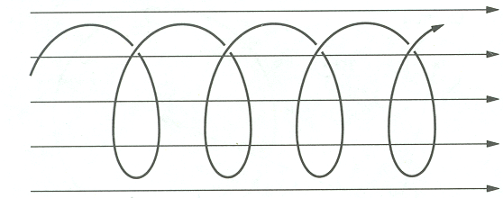
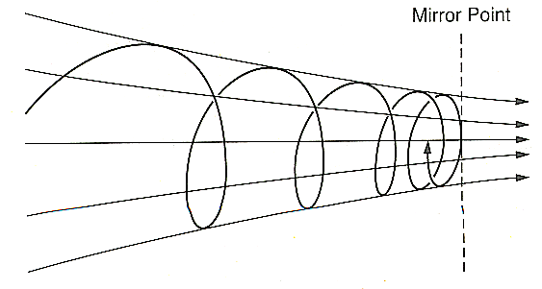
Charged Particle in Magnetic Field
If the initial velocity is not perpendicular to the field, the motion in constant field will be circular plus a constant velocity parallel to the field—a helix.
If the field is becoming stronger in the direction of motion, the helix gets tighter, and finally reverses. This is a magnetic mirror, used to confine plasmas in prototype fusion reactors.
.
The slope of the field lines gives a “backward” component to the magnetic force.

Slide 12
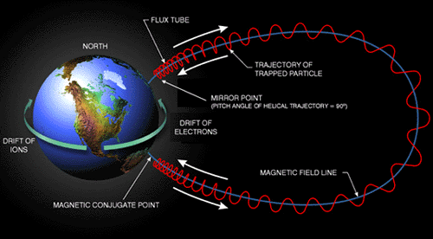
Large-Scale Magnetic Confinement
The van Allen radiation belts are filled with charged particles moving between two magnetic mirrors created by the Earth’s magnetic field. The outer belt is mostly electrons, the inner one mostly protons.

Slide 13
Torque on a Current Loop
b
Take first an axb rectangular loop, horizontal, in a uniform magnetic field with field lines parallel to the end sides of the loop.
The forces on the other sides are vertical as shown, with magnitude IℓB = IaB, and torque about the axis:
.
a
loop area A = ab
b/2
end view

Slide 14
Current Loop at an Angle
The loop has a magnetic field resembling that of a short bar magnet, we define the direction of the loop area as that of the semi equivalent bar magnet.
The torque is
is the magnetic dipole moment, in exact analogy with the electric .
.
current out
b/2
current in
end view

