Slide 1
More Electric Fields
Physics 2415 Lecture 3
Michael Fowler, UVa

Slide 2
Today’s Topics
Continuous charge distributions: line of charge
Visualizing the field: lines of force
Electron moving in a field
Electric dipoles

Slide 3
Superposition
The total electric force on a charge Q₃ from two charges Q₁, Q₂ is the vector sum of the forces from the charges found separately.
Sounds trivial—but superposition isn’t true for nuclear forces!

Slide 4
Field from Two Equal Charges
Two charges Q are placed on the y-axis, equal distances d from the origin up and down. What is the electric field at a point P on the x-axis, and where is its maximum value?
Anywhere on the axis, the field is along the axis, and has value
y-axis
Q
d
P
x-axis
x
d
Q

Slide 5
Field from a Uniform Line of Charge
What’s the electric field at a point P distance R from a very long line of charge, say C/m?
Take the wire along the z-axis in 3D Cartesian coordinates,we’ll find the field at a point P, distance R from the wire, in the (x,y) plane.
The strategy is to find the field z from a bit dz of the wire, then do an integral over the whole wire.
q
z-axis
dz
P
O

Slide 6
Field from a Uniform Line of Charge
The strategy is to find the field z from a bit dz of the wire, then do an integral over the whole wire.
For an infinite wire, the net field must be directly away from the wire, so multiply by and integrate over all z :
q
z-axis
dz
P
O

Slide 7
Electric Field from a Plane of Charge
It’s worth drawing the field lines to emphasize that the electric field from a uniformly charged plane is directly outward from the plane.
Charge density:
σ Coulombs/m²
a

Slide 8
Field for Two Oppositely Charged Planes
a
+
=
Superpose the field lines from the negatively charged plate on the parallel positively charged one, and you’ll see the total field is double in the space between the plates, but exactly zero outside the plates.

Slide 9
Motion of an Electron Between Two Oppositely Charged Plates
a
Two uniformly charged plates with equal but opposite charge generate a uniform electric field between them, except near the edges.
An electron entering this region will feel a constant downward force, and act exactly like a projectile under gravity, with downward acceleration eE/m.

Slide 10
Field of Two Equal Charges off the Axis
Close to one of the charges, its own field dominates. On the axis between them, the field is along the axis.
To find the field elsewhere, we must add the two field vectors, and so can trace lines of force.
a

Slide 11
Field Lines for Two Equal Charges
The lines are more crowded where the field is stronger, but at the central point there is zero field strength—the vertical lines go into that point, the horizontal lines come out.

Slide 12
Field on Axis from Two Opposite Charges
This is a dipole: the analysis is just like the two equal charges case:
Anywhere on the axis, the field is downward, and has value
y-axis
Q
d
P
x-axis
R
d
-Q

Slide 13
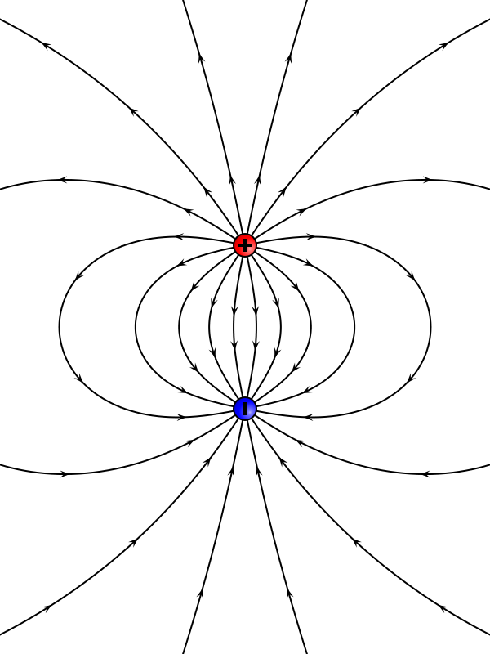
The Dipole Field
Notice that the field lines near a charge are dominated by that charge, and that they cross the axis at right angles.
d

Slide 14
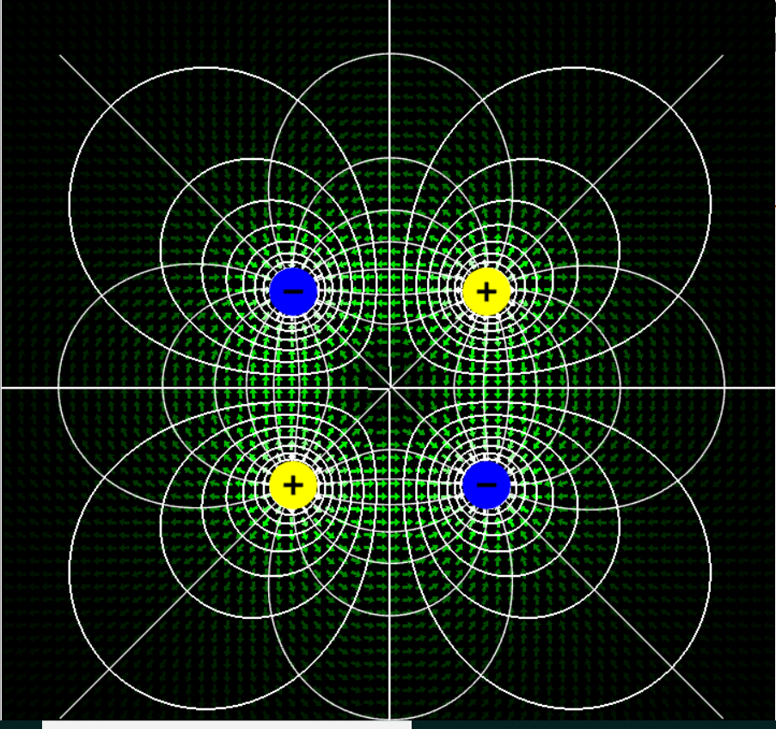
More Electric Field Lines…
For nonequal charges, and more general charge distributions, check out the fantastic applets at falstad.com!

Slide 15
Molecular Dipoles
Many molecules, for example H₂O, are actually electric dipoles—all that’s necessary is that the center of negative charge isn’t the same point as the center of positive charge.
A small dipole will line up in an external electric field just as a compass needle (which is a magnetic dipole) lines up in the Earth’s magnetic field.

Slide 16
Torque on a Dipole in an Electric Field
For a dipole +Q, -Q separated by a distance as shown, the dipole moment is defined as a vector length and direction along the line from –Q to +Q.
The torque
d
+Q
-Q

Slide 17
Potential Energy of Dipole in Electric Field
Taking the dipole initially perpendicular to the field, if it turns to angle the electric forces have pushed the charges distances in their direction of action, so have done work
Therefore the potential energy of the dipole is:
d
+Q
-Q

Slide 18
Potential Energy of Dipole in Electric Field: Torque Approach
A torque does work
on turning through angle ,
so the total work on going
from is:
+Q
d
-Q
Why is this negative? Remember when an object falls, the gravitational force does positive work on it, and it’s losing that amount of potential energy.

Slide 19
Microwaving Water Dipoles
Recall the water molecule has the Mickey Mouse shape, the H’s share their electrons, so there’s extra positive charge in those ears, a dipole moment of strength p = 6.2 x 10⁻³⁰ C.m.
This tends to orient the molecule with the electric field.
In a microwave, the strong electric field changes direction billions of times per second—the molecules constantly adjust, bumping into each other, creating heat.
Ice doesn’t absorb the energy so well. Why?
H
H
H
O

