Slide 1
Projectiles
Physics 1425 Lecture 5
Michael Fowler, UVa.

Slide 2
Reminder: Galileo’s Laws of Motion
Neglecting air resistance and friction, Galileo claimed:
Horizontal motion: (ball rolling on table) an object would continue to move at constant velocity unless pushed.
2. Vertical motion: a falling body would accelerate downwards at a uniform rate.

Slide 3
Galileo’s Law for Projectiles
He asked himself: what would happen if the ball rolled off the table?
He claimed (and established experimentally) that the balls uniform horizontal motion would continue as before –
BUT natural vertical falling motion would be added!
He termed the result “compound motion”.

Slide 4
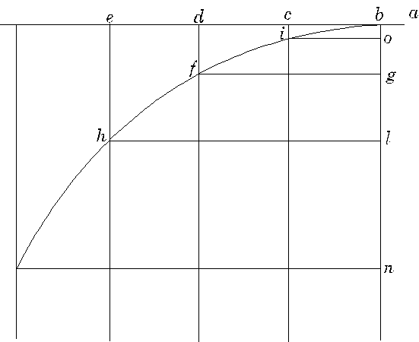
Here’s Galileo’s own picture … and here’s a link to an animation.

Slide 5
Equation for the Trajectory
Taking t = 0 to be when the ball rolls off the edge, and the origin O at that point,
from which
The standard parabola equation is y = ax², so this is half of an upside-down parabola.

Slide 6
Clicker Question
Suppose that as the ball rolling across the table goes over the edge, it touches another ball that was just balanced on the edge. Assume the first ball’s trajectory is not changed, the second ball falls vertically down.
The rolling ball hits the ground first
The dropping ball gets there first
They hit the ground at the same time

Slide 7
Car Goes Horizontally Over Cliff
Position at 1 second intervals (v₀ = 20 m/s)
g=0 trajectory
in red
Taking g = 10, positions are (0, 0), (20, -5),
(40, -20), (60, -45).
Velocities and Speeds at 1 second intervals:
Speeds are approx:
20, 22, 28, 36 m/s.

Slide 8
Full Projectile Path
A projectile is shot at some upward angle from the origin: see animation.
Galileo tells us the horizontal motion is just steady velocity, the vertical motion is the same as that of a ball thrown directly upwards.
Therefore
Eliminating t gives a parabolic curve through O:

Slide 9
Vector Picture of Projectile Motion
Position at 1 second intervals (notice it falls below straight line: the g =0 trajectory).
Velocities and Speeds at 1 second intervals.

Slide 10
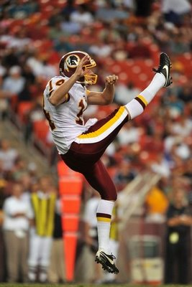
Hang Time
How long does it take the ball to go up and come back down again?
Initial upward velocity v_{0y}, upward velocity changes by –g each second, back down at –v_{0y}, so gt = 2v_{oy}
Hang time:
http://curlyr.blogspot.com/2008_09_01_archive.html

Slide 11
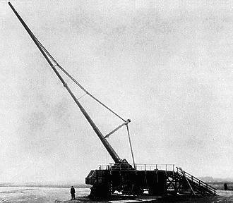
Range
A
The Paris gun, used by the German army to shell Paris in 1918. Its range was about 80 miles, 130 km.
Given the initial velocity
The hang time is
and during that time the shell travels a horizontal distance
This is the range.
http://en.wikipedia.org/wiki/File:Parisgun2.jpg

Slide 12
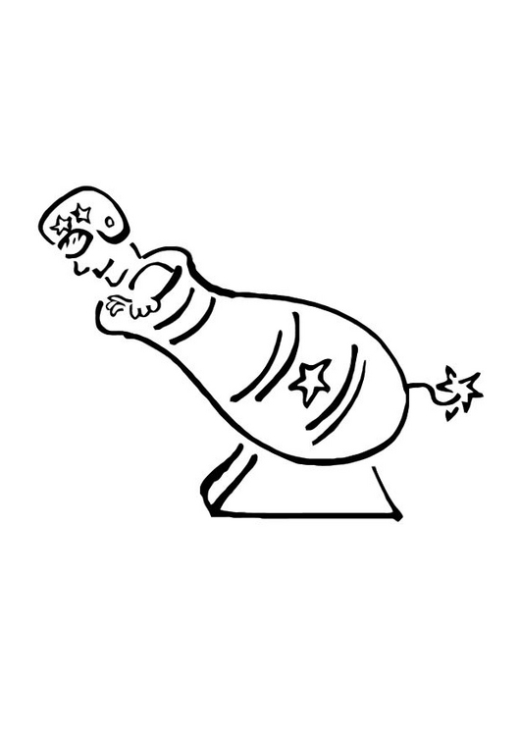
Maximum Range
A
http://www.edupics.com/human-cannon-t10746.jpg
Taking the muzzle velocity as fixed, how do we vary the angle of firing to maximize the range?
Now
So
And maximum range at 45°

