Slide 1
Gas Processes and Heat Transport
Physics 1425 Lecture 34
Michael Fowler, UVa

Slide 2
The First Law of Thermodynamics
A closed system has a total internal energy E_{int}.
This energy can be changed in two different ways:
The system can do work W, or have work done on it, -W.
Heat Q can flow into the system, or -Q flow out.
The First Law is just total energy conservation:
ΔE_{int} = Q – W
Change in internal energy = heat in – work done.

Slide 3
States of an Ideal Gas
Suppose we have n moles of an ideal gas in equilibrium in a piston. The “state” of the gas can be defined by giving the state variables P, V. The gas state is a point in the (P, V) plane.
If heat is exchanged or work done, the gas state variables trace a path in the (P, V) plane.
If the gas moves along an isotherm PV = constant, its internal energy stays the same.
Z
P
V
The temperature (and therefore internal energy) is constant along an isotherm, PV = const.

Slide 4
The Gas Does Some Work
The gas pressure P means the force from the gas on the piston, of area A, is PA. This means that if the piston moves up a distance dℓ, the work done by the gas, force x distance = PAdℓ =PdV.
The work done by the gas in expanding isothermally, along PV = nRT, is
a
dℓ
Area A

Slide 5
States of an Ideal Gas
Note that the work done by the gas in isothermal expansion
is just the area under the path—and in fact this must be true of the work done along any path.
The gas clearly does less work going from A to B on the red path.
This means less heat is supplied to the gas along the red path!
Z
P
A
B
V_{A}
V_{B}
V
P
V_{A}
V_{B}
V

Slide 6
Clicker Question
What is the true heat difference between state A and state B?
The heat needed to get from state A to state B along the isotherm.
The heat supplied going along the red route.
The heat needed along a minimal heat transfer route, which may be different from either.
The question doesn’t make sense.
Z
P
A
B
V_{A}
V_{B}
V
P
V_{A}
V_{B}
V

Slide 7
Specific Heats of a Mole of Ideal Gas: C_{V}
If we heat up a gas by 1°C at constant pressure, it will expand and do work, so we must supply more heat (to do this work) than if it is heated by 1°C when kept at constant volume.
Recall that the internal energy of a mole of gas is E_{int} = N_{A}kT = RT.
Therefore, the heat energy input to raise the temperature 1°C at constant volume, the constant volume specific heat C_{V} is just
C_{V} = R (R = 8.3 J/mol∙K)

Slide 8
Specific Heats of a Mole of Ideal Gas: C_{P}
The constant volume specific heat C_{V} is just
C_{V} = R (R = 8.3 J/mol∙K)
For one mole of gas, PV = RT, so at constant pressure PΔV = RΔT = R for a temperature increase of 1°C (or equivalently 1K).
This equation also tells us the work done in expanding at constant pressure, PΔV = R for one degree—so an extra R Joules of energy must be supplied above that needed for C_{V},
C_{P} = C_{V} + R = ⁵/₂ R

Slide 9
Molar Specific Heats of Real Gases
For monatomic gases (He, Ne, Ar) at room temperature, the ideal gas values C_{V} = R and C_{P} = C_{V} + R are good to three significant figures.
BUT for diatomic gases, C_{V} = (5/2)R, C_{P} = C_{V} + R!
Visualize the diatomic molecules as little dumbbells flying around. When two collide, they can set each other spinning.
It can be shown by applying Newton’s laws to the collisions that on average the spinning motion will have equal energy with the translational motion: this is called the Equipartition of Energy .

Slide 10
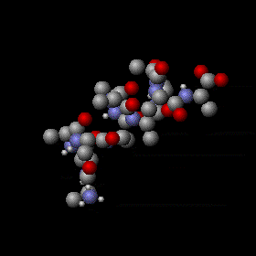
Equipartition of Energy:
Degrees of Freedom
For the ideal monatomic gas, we say the atoms have three degrees of freedom, the three different directions x, y, z and the total kinetic energy is . The average atomic KE is kT per degree of freedom, for a total kT.
The diatomic gas has specific heat 2.5kT: evidently there are two more degrees of freedom: obviously rotation about axes perpendicular to the line of the molecule.
Bigger molecules have many more possibilities, like vibrational energy.

Slide 11
An Equipartition Puzzle:
Specific Heat of H₂ as a Function of T
    What’s going on here?
3.5R
2.5R
1.5R
25
50
100
200
400
800
1600
3200K

Slide 12
An Equipartition Puzzle:
Specific Heat of H₂ as a Function of T
    What’s going on here?
Vibrational mode kicking in.
3.5R
2.5R
Rotational modes getting their share.
1.5R
At low temperatures, H₂ acts like a monatomic gas. No thermal energy is going into the rotational modes, even though the molecules are colliding!
25
50
100
200
400
800
1600
3200K

Slide 13
Puzzle Answered: the Quantum Theory
Newton’s Laws don’t work here. This temperature dependence of the specific heat of real H₂ gas can only be understood with quantum mechanics!
It turns out that the angular momentum of a spinning object can only have values which are whole numbers times ℏ, where ℏ is Planck’s constant/2π, ℏ = 1.06 x 10⁻³⁴ J∙sec.
The H₂ molecule has such a tiny moment of inertia it takes quite a kick to spin it fast enough for the minimum allowed angular momentum—so it doesn’t get to spin at low temperatures.

Slide 14
Molar Specific Heat of Solids
Many simple solids, such as elements, can be pictured as a lattice of balls connected by springs, a 3-D version of this:
Each atom acts like an oscillator with three degrees of freedom, each degree has both KE and PE, suggesting a molar specific heat of 3R.
This is just the Dulong Petit value, and works well for many elements except at low temperatures …
H

Slide 15
Molar Specific Heats of Copper and Diamond
3R
2R
Amost all elements are like copper: 3R at room temperature. What’s so special about diamond?
It took Einstein to figure it out…
R
0
200
400
600
800
1000
1200
1400K

Slide 16
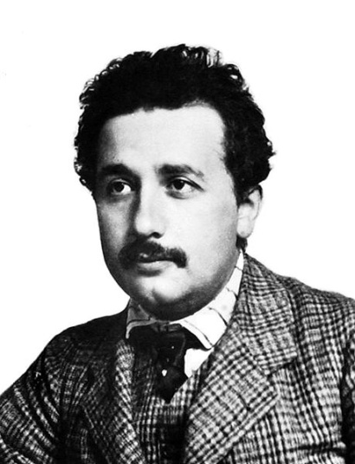
Einstein Solves the Puzzle
Einstein assumed each atom was basically a 3D mass-on-a-spring oscillator.
The difference with diamond is that its masses are quite small (carbon) and its springs are very strong—diamond is hard! This means the oscillators have very high frequency ω.
Einstein suggested that like the rotators, these oscillators could only absorb energy in chunks, called quanta, and one chunk was ℏω – the same ℏ as the rotators.
That means higher frequency diamond oscillators could only absorb energy in bigger chunks—so they froze out at low temperatures.
Copper’s oscillators freeze out too—but at lower T.

Slide 17
Clicker Question
At the liquid nitrogen boiling temperature (77K) the molar specific heat of copper is about half its room temperature value.
What would you expect the molar specific heat of lead to be at that temperature?
Less than copper
The same as copper
Higher than copper.
Hint: think of the atom oscillators. Is lead hard? Is it heavy?

Slide 18
Adiabatic Expansion of an Ideal Gas
“Adiabatic” is Greek for “nothing gets through”—here it means no heat gets into or out of the gas. Therefore, for one mole,
dE_{int} = C_{V} dT = -PdV
From PV = RT, RdT = PdV + VdP, putting that dT in the equation, and defining γ = C_{P}/C_{V}, we can show that VdP + γPdV = 0, which integrates to
PV ^{γ} = constant.

Slide 19
Clicker Question
Two identical cylinders contain the same volume V of ideal gas, initially at the same temperature and pressure.
Gas A is then compressed adiabatically to ½V, and gas B is compressed isothermally to ½V.
Which is now at the greater pressure?
A
B
They’re equal.

Slide 20
Isotherms and Adiabats
Adiabats are steeper than isotherms because work done compressing the gas along the adiabat all goes into internal energy—the gas heats up. Compressing along the isotherm, the gas continuously sheds heat.
a

Slide 21
Heat Conduction
Heat conduction through solids acts just like a fluid flow—that’s why the caloric theory worked so well. The flow of heat down a rod is proportional to the temperature gradient (like a river flowing downhill), proportional to the cross-section area of the rod (like water in a pipe) and varies from material to material depending on the “thermal conductivity” k, a property of the material.

Slide 22
Heat Flow down a Rod
For a rod of material with thermal conductivity k, length ℓ and cross-section area A, the heat flow ΔQ in time Δt is given by:
or differentially

Slide 23
Microscopic Picture of Heat Conduction
If one end of a nonmetallic rod is heated, the atom near that end vibrate more vigorously and emit tiny sound waves, called phonons, that travel down the rod. These go at the speed of sound, but are easily scattered by impurities or lattice defects, so they actually diffuse down the rod, like molecules in a gas, and in comparable times—they move at similar speeds to molecules and in many solids have mean free paths of tens or hundreds of atomic spacings.

Slide 24
Heat Conduction in Metals
Metals are shiny materials that conduct electricity well. Both these properties are due to the presence of large numbers of “free electrons”—electrons not bound to individual atoms, but free to move through the material. (We’ll understand why that makes them shiny next semester.)
The electrons are excellent conductors of heat—they move very fast and have long mean free paths.
Metals typically conduct heat a hundred times better than nonmetals.

Slide 25
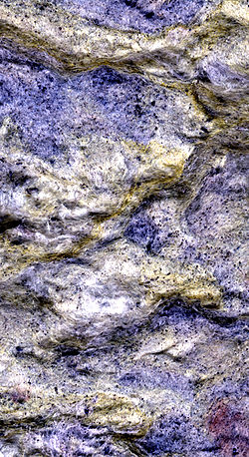
Heat Insulators
Heat insulators are solids that are in fact mostly air—rockwall insulation has a density about 12% that of water, it’s just full of tiny holes filled with air, and air is a poor conductor of heat—heat moves through the atmosphere by convection and radiation. These holes are too small for convection currents to get set up.
Goosedown and polyurethane are even better heat insulators, but lack structural strength.

Slide 26
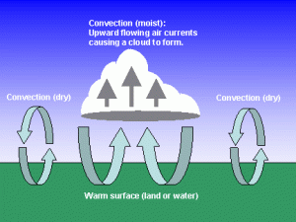
Convection
If a fluid is heated from below, like the atmosphere over hot ground, the less dense air moves upwards. If it contains moisture, this may eventually condense out as the temperature drops below the dew point, forming a cloud.
Convection works upside down to cool a lake from the surface downwards as winter begins—BUT stops at 4°C – below that temperature the water’s density decreases, and the cold stays on top.

Slide 27
Radiation
All bodies radiate thermal energy: this radiation is electromagnetic waves generated by the motion of electric charges oscillating with the heat vibrations in the solid. (This will be discussed much more next semester.)
The intensity of radiation from a surface, in watts/sq m, depends on the surface material: it’s proportional to an experimentally determined coefficient of emissivity, called e or ε, varying from 0 to 1, 1 being the best possible radiator.
ε = 1 is called a perfect black body.

Slide 28
Solar Radiation
The intensity of black body radiation varies with absolute temperature,
I = σT⁴ watts/m²
where Stefan’s constant σ = 5.67 x 10⁻⁸ watts/m²∙K⁴.
The sun, at 5780K, radiates about 60 megawatts per square meter of surface. This reaches Earth at an intensity of 1.35kW/sq m (above the atmosphere), this is called the solar constant.

Slide 29
Radiation Equilibrium
You are currently radiating energy proportional to the fourth power of your temperature in kelvins. But so is everyone else, and the walls, etc., so you are also receiving radiant energy.
If an object is left in a constant temperature room, it reaches that temperature and stays there. This means its ability to absorb radiant energy must exactly equal its emissivity.
Before reaching equilibrium, the energy transfer rate per sq m of surface is ε σ (T_{obj}⁴ - T_{room}⁴).

Slide 30
