Slide 1
Kinetic Theory of Gases
Physics 1425 Lecture 31
Michael Fowler, UVa

Slide 2
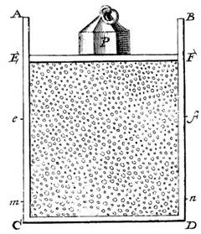
Bernoulli’s Picture
Daniel Bernoulli, in 1738, was the first to understand air pressure in terms of molecules—he visualized them shooting around very rapidly in a closed container, supporting a weight as shown by constantly bouncing off the underside of the piston.
Given more room, they would rush in to fill the new space, just as a gas is observed to do.
No-one believed him.

Slide 3
One Dimensional, One Molecule Gas
The molecule roundtrips in time 2L/v, so it bounces off the piston v/2L times per sec, each time delivering momentum 2mv, so the piston will pick up momentum from this “gas” at rate 2mv x v/2L per second.
Force from gas on piston:
F = rate of change of momentum = mv²/L. An equal opposite force must be supplied from outside to keep the piston at rest.
Animation!
V
L
v
1-D gas: molecule bounces between ends of cylinder.

Slide 4
Molecule in a Two-Dimensional Box
Assume perfectly elastic collisions with all walls.
The molecule will follow a zigzag path, the time between collisions with the same end, say the end at x = L, is now 2L/v_{x}, and the momentum transferred per collision is 2mv_{x}, so the average force on the end is mv_{x}²/L.
This will still hold good in three dimensions.
a
y
v_{y}
v_{x}
0
x
L

Slide 5
N Molecules in an L x L x L Cube
Assume first that we have a very large number N of molecules bouncing around, so small that they don’t hit each other, each follows its own zigzag path.
The force on the right-hand wall at x = L is just the sum of the forces from each one, so
F = mv_{x1}²/L +mv_{x2}²/L +mv_{x3}²/L + … + mv_{xN}²/L .

Slide 6
Bar Means Average
The force on the wall depends on the sum
We don’t need the individual values v_{x1}², etc., just the average, written with a bar:
So the force on the wall is:

Slide 7
Gas Molecules Have Random Velocities…
Gravity has a negligible effect on the speeds, so all directions look the same to the gas molecules.
This means:
and since the molecular speed squared
it follows that

Slide 8
Relating Pressure to Molecular Energy
Our gas of molecules is in an L x L x L cube, the force on one wall (which has area L²) is
So the pressure P, force per unit area, is (V = L³)
Now we’ll multiply both sides by V …

Slide 9
Finding the Ideal Gas Law
We’ve established that
and we know that for very weakly interacting gases, PV = nRT. These two equations must be the same!
The equivalence is most simply expressed using Boltzmann’s constant, k = R/N_{A} (= 1.38 x 10⁻²³ J/K).
PV =nRT = nN_{A}kT = NkT, so
Absolute temperature is proportional to average molecular kinetic energy.

Slide 10
Average Speed of Air Molecules
Maxwell and co were very smart guys—they figured out accurately the average speed of air molecules before they had any idea how big the molecules were!
They just used
where M is the total mass of the gas in the box.

Slide 11
Average Speed of Air Molecules
Let’s see what gives for the speed of air molecules in this room (we are, of course, averaging here over oxygen and nitrogen plus a tiny amount of other stuff).
Let’s take a one meter cube: it will contain about 1.3 kg of air. The pressure P = 10⁵ N/m², close enough, so
giving the root mean square value .

Slide 12
Clicker Question
Since oxygen, nitrogen and helium all satisfy the same gas law PV = nRT at room temperature, we conclude that:
All have the same (rms) root mean square average molecular speed
All have the same average molecular kinetic energy
Neither of the above is true.

Slide 13
Clicker Question
If we take the average speed of oxygen molecules in this room to be 480 m/s, what would be the average speed of helium atoms that leaked from a balloon into the room?
480 m/s
960 m/s
1360 m/s
1920 m/s

Slide 14
The Speed Distribution
Although the molecules fly freely almost all of the time, they do collide occasionally.
Assuming random elastic collisions, there will be transfer of energy, typically of order kT, from one to another in a collision.
The chances of a particular molecule picking up kT n times in a row is similar to the chances of a coin toss coming up heads n times in a row…. that is, high energies are exponentially unlikely.

Slide 15
Maxwell’s Speed Distribution
Maxwell did the math precisely, and found the probability of a molecule having a high energy at a given moment did drop exponentially with energy:
meaning that for each extra kT of energy, the probability of finding a particle with that energy drops by 1/e ≈ 0.37 —more than a factor of 2, because the average amount picked up per collision is less that kT.
Watch a 2D example of molecules all starting with the same speed ending at a Maxwell distribution here!

Slide 16
Escaping from a Planet
Maxwell’s speed distribution makes it quite easy to predict which gases can escape from planetary atmospheres.
For the Earth, v_{escape} = 11 km/sec.
The upper atmosphere has parts as hot as 1000K.
The speed distribution includes where we’ve used .
For H₂, at 1000K, the fraction of molecules at escape velocity is of order 10⁻⁶, for He 10⁻¹², for O₂ 10⁻⁷⁹. This means the H₂ will escape almost instantly, the He pretty quickly, and the O₂ never.

Slide 17
Clicker Question
Which of the following gases would you expect to be dominant in the Martian atmosphere?
H₂
He
N₂
H₂0
CO₂

Slide 18
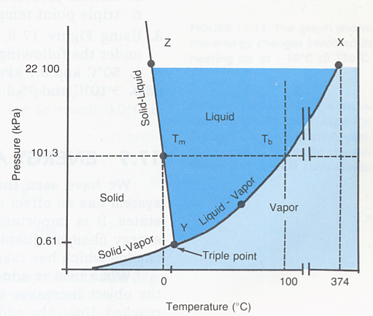
Real Gases
(This is of course chemistry.)
Water has the three phases as shown on this pressure/ temperature graph.
They meet at the “triple point” a definite P and T, useful as a reference point in fixing temperatures.
Freezing and boiling points vary with pressure.
At the critical point, liquid and vapor become the same.
The solid-liquid dividing line slopes forwards for almost all substances—water is an exception.

Slide 19
Vapor Pressure and Humidity
The H₂O molecules in liquid water strongly attract each other, holding the liquid together. But these molecules are still jiggling around, with a Maxwell speed distribution. This means a fraction of them near the surface are moving fast enough to escape, forming a vapor above the surface.
In a closed container, with enough water present, an equilibrium situation is reached between escaping and returning molecules.

Slide 20
Water and Vapor in Equilibrium
In equilibrium in a closed container, the molecules in the vapor have the same average kinetic energy as the air molecules, so exert pressure on the walls of the container proportionate to their numbers.
This is the saturated vapor pressure. It varies with temperature like e^{−a/T}, not surprising since its origin is molecules fast enough to escape.
a
Air + water vapor
Water

Slide 21
Water Vapor Pressure
At room temperature, saturated vapor pressure is about 2.5% of atmospheric pressure.
At 100°C, it equals atmospheric pressure: this means small bubbles formed in the liquid by fast moving molecules coming together are no longer crushed by the surrounding atmospheric pressure, the water boils.
In mountain resorts like Aspen, water boils at a lower temperature, producing inferior tea.

Slide 22
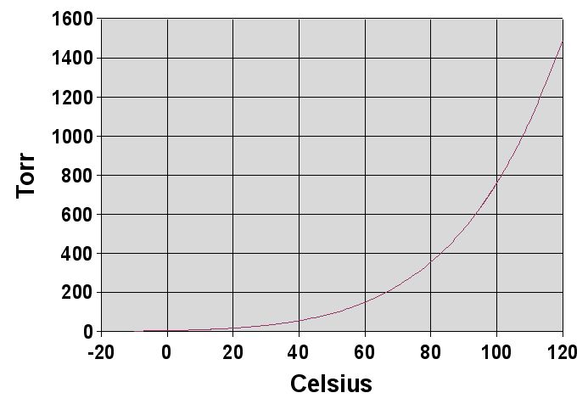
H₂O Saturated Vapor Pressure
mm Hg
atmospheric pressure
http://upload.wikimedia.org/wikipedia/commons/2/25/Water_vapor_pressure_graph.jpg

Slide 23
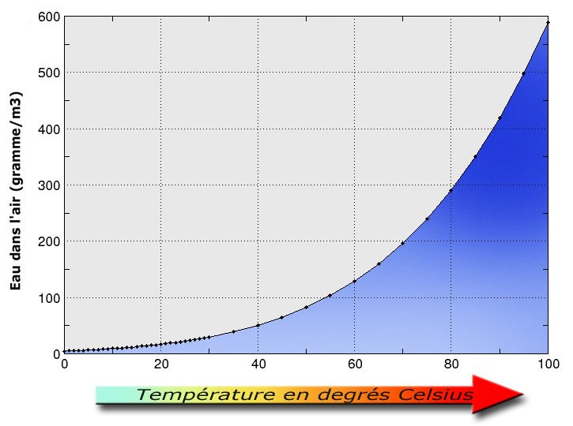
100% humidity: grams of H₂O per 1m³ air
http://upload.wikimedia.org/wikipedia/commons/7/7c/Hygrom%C3%A9trie_et_temp%C3%A9rature.jpg

Slide 25
Relative Humidity and Dew Point
If water is constantly boiled off in a closed room, it is not possible to establish an equilibrium situation with vapor pressure above the saturated value for that temperature —further water will condense out on the walls, etc. At this point, relative humidity = 100%.
Relative humidity =
vapor pressure/saturated vapor pressure
Dew point: temperature at which dew forms—that is, water condenses out as the air cools.

