Slide 1
Damped and Driven Harmonic Motion
Physics 1425 Lecture 29
Michael Fowler, UVa

Slide 2
Damped Harmonic Motion
In the real world, oscillators experience damping forces: friction, air resistance, etc.
These forces always oppose the motion: as an example, we consider a force F = −bv proportional to velocity.
Then F = ma becomes:
ma = −kx −bv
That is,
C
Spring’s force
Drag force
m
Extension x
The direction of drag force shown is on the assumption that the mass is moving to the left.

Slide 3
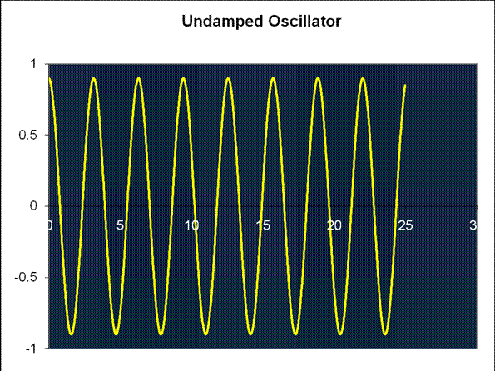
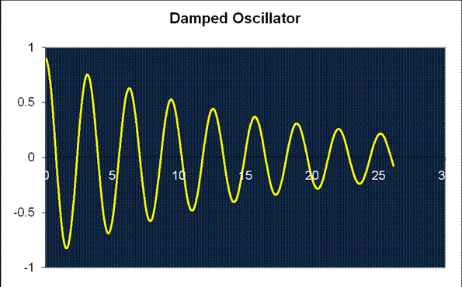
Underdamped Motion
The equation of motion
has solution
where
Plot: m = 1, k = 4, b = 0.11

Slide 4
Underdamped Motion
The point to note here is that the damping can cause rapid decay of the oscillations without a perceptible change in the period (around 0.04% for b = 0.11, k = 4, m = 1).

Slide 5
Underdamped Motion
Compare the curve with the equation: the successive position maxima follow an exponential curve , so any maximum reached is, say, 90% of the previous maximum.
Remember the energy at maximum displacement is ½kx².
a

Slide 6
Clicker Question
The amplitude in a damped oscillator reaches half its original value after four cycles. At which point does the oscillator have only half its original energy?
2 cycles
4 cycles
8 cycles

Slide 7
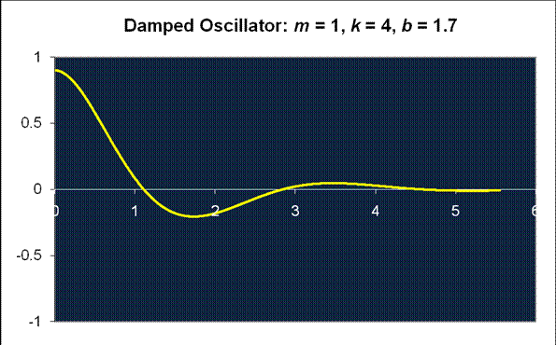
Not So Underdamped Motion
Even when the damping absorbs 98% of the energy in one period, the change in the length of the period is only around 10%!
a

Slide 8
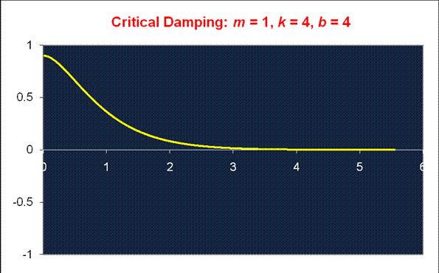
Critical Damping
As the damping is further increased, the period lengthens until at b² = 4mk it becomes infinite, and the amplitude decays exponentially.
(Actually, in this one case a prefactor A + Bt is needed to match initial conditions—we’ll ignore this minor refinement.)

Slide 9
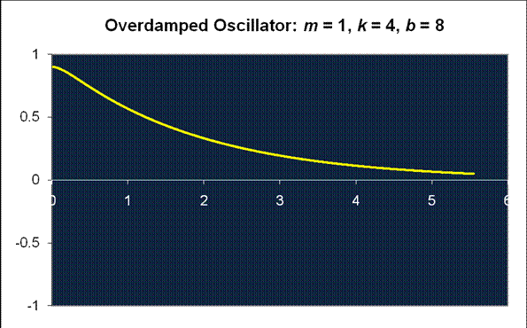
Overdamping
Doubling the damping beyond critical damping just doubles the time for the amplitude to decay by a given amount.

Slide 10
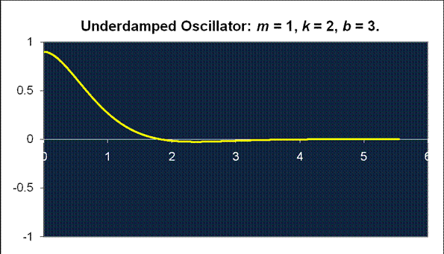
Ideal Damping for Shock Absorbers?
Critical damping is not the best choice: underdamping gives a quicker response, and the overshoot can be very small.
Explore this for yourself with this applet!

Slide 11
The Damped Driven Oscillator
We now consider a damped oscillator with an external harmonic driving force.
We’ll look at the case where the oscillator is well underdamped, and so will oscillate naturally at .
The external driving force is in general at a different frequency, the equation of motion is:

Slide 12
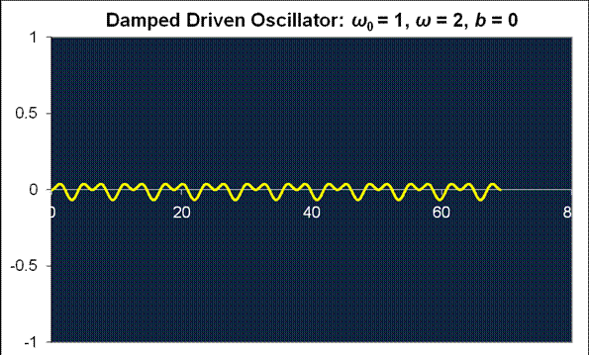
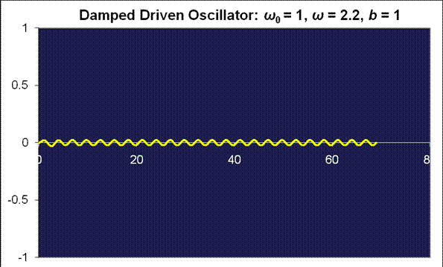
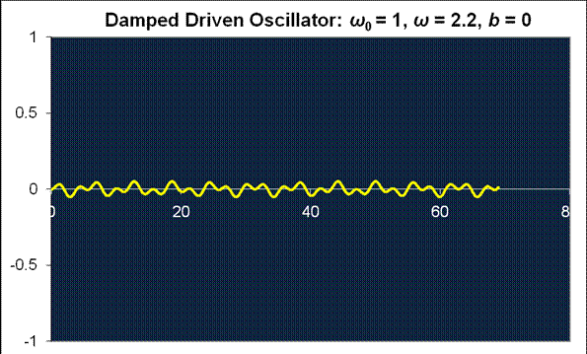
The Damped Driven Oscillator
If the driving frequency is far from the natural frequency, there is only a small response, even with no damping. Here the driving frequency is about twice the natural frequency.

Slide 13
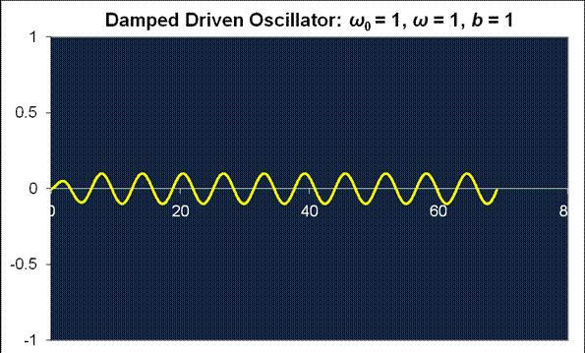
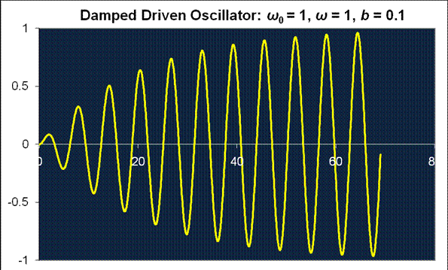
The Damped Driven Oscillator
This shows the oscillator with the same strength of external driving force, but at its natural frequency.
The amplitude increases until damping energy losses equal external power input: this is resonance.
Applet link!
Tacoma Narrows Bridge.

