Slide 1
Hydrodynamics
Physics 1425 Lecture 27
Michael Fowler, UVa

Slide 2
Basic Concepts
Fluid conservation
Bernoulli’s Equation

Slide 3
You are sitting in a rowing boat in a small pond. There are some bricks in the boat. You take the bricks and throw them into the pond. They sink to the bottom.
What happens to the water level in the pond, as measured at the bank?
It falls.
It rises.
It stays the same.

Slide 4
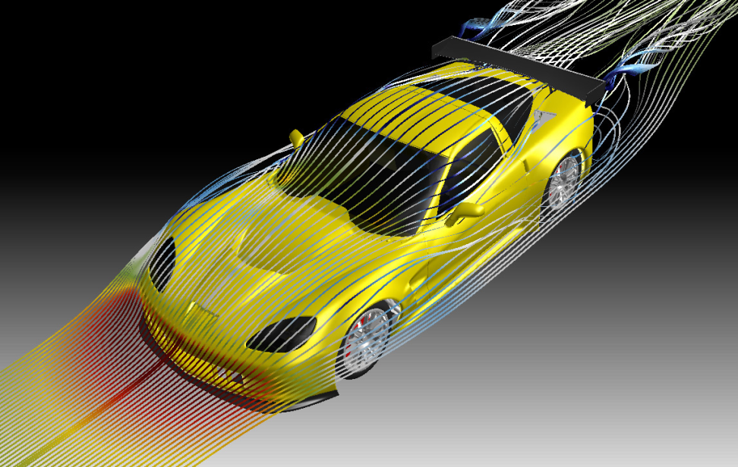
Fluid Flow: Laminar and Turbulent
In laminar or streamline flow, each particle of fluid follows a smooth path, the streamline.
Air flow over this Corvette is laminar until the end: the air cannot curve in completely at the back, it breaks away forming a turbulent wake.

Slide 5
Conservation of Fluid
Δℓ₁
Suppose fluid is flowing steadily through a pipe which has a narrow section.
The rate of flow, gallons per sec or cubic meters per sec, must be the same past a point in the narrow part as past a point in the wide part—or fluid will be piling up somewhere!
So it flows faster through the narrow part.
Δℓ₂
area A₁ area A₂
Imagine a short cylinder of the fluid, of length Δℓ₁ in the wide part—as it squeezes into the narrow part it gets longer.
The total mass of fluid Δm in the short cylinder is density x area x length, so
Δm = ρΔV = ρ₁A₁Δℓ₁ = ρ₂A₂Δℓ₂

Slide 6
Fluid Velocity: Equation of Continuity
Δℓ₁
Δℓ₂
Area A₁
Area A₂
If the fluid flows distance Δℓ₁ in the wide tube in time Δt, the mass flow rate past a point is Δm/Δt = ρ₁A₁Δℓ₁/ Δt = ρ₁A₁v₁.
Since the mass flow rate through area A₁ must equal that through A₂ for steady flow,
ρ₁A₁v₁ = ρ₂A₂v₂
the “equation of continuity” and often the ρ’s can be dropped—water is essentially incompressible, and at low speeds so is air.

Slide 7
Clicker Question
A
C
B
Where will the pressure be greatest in steady fluid flow?
The entering wide part
The central narrow part
The final wide part

Slide 8
Clicker Answer
A
C
B
Where will the pressure be greatest in steady fluid flow?
The portion of fluid speeds up as it enters the narrow part—this can only happen if it’s pushed from behind. This means the pressure behind is greater.
As it leaves the narrow part, it slows down: again, the pressure is greater in the wide part.

Slide 9
Bernoulli’s Equation
Δℓ₁
Δℓ₂
Area A₁
Area A´₁
Area A₂
Area A´₂
Focus now on the block of fluid that’s between A₁ and A₂ at one instant in time.
After time Δt, that same fluid will now be between the downstream areas A´₁ and A´₂, and it’s picked up some KE!
A mass Δm = ρ₁A₁Δℓ₁ moving at v₁ has been replaced by mass ρ₂A₂Δℓ₂ moving faster—at v₂. From continuity, these masses are the same—so taking ρ constant, there is a KE gain of
½Δm(v₂² – v₁²) = ½ρA₁Δℓ₁(v₂² – v₁²).

Slide 10
Bernoulli’s Equation
For constant density, A₁Δℓ₁ =A₂Δℓ₂
Δℓ₁
Δℓ₂
Pressure P₁
Area A₁
Area A´₁
Area A₂
Area A´₂
In the time Δt, there is a KE gain of ½ρA₁Δℓ₁(v₂² – v₁²).
Where did that energy come from?
In the time Δt, the pressure P₁ on the area A₁ does work:
force x distance = P₁A₁Δℓ₁
BUT at the same time, our block of fluid did some work itself: it pushed the fluid in front of it, doing work = P₂A₂Δℓ₂.
SO net work done = (P₁ - P₂) A₁Δℓ₁ =KE gain ½ρA₁Δℓ₁(v₂² – v₁²)
That is, P₁ + ½ρv₁² = P₂ + ½ρv₂²

Slide 11
Uphill Work…
What if the pipe is tilted upwards?
Now the pressure speeding the fluid along has to lift it as well!
So the pressure adds potential energy corresponding to how much it was lifted as well as kinetic energy from speeding it up.
This gives the full Bernoulli’s equation:
P₁ + ½ρv₁² + ρgy₁= P₂ + ½ρv₂² + ρgy₂
V
y
(vertical)
x

Slide 12
I hold two sheets of paper hanging from my hands parallel, one or two inches apart.
I blow between the two sheets.
What happens?
They move towards each other.
They move apart.

Slide 13
Torricelli’s Theorem
Water coming from a small spigot in a large tank has a speed given by
v² = 2gh
This is a special case of Bernoulli’s equation, because the outside pressure at the spigot is the same as that at the top of the fluid, and fluid velocity at the top is negligible.
x
h

