Slide 1
Hydrostatics
Physics 1425 Lecture 25
Michael Fowler, UVa

Slide 2
Basic Concepts
Density
Pressure: Pascal’s Principle

Slide 3

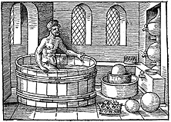
The Crown and the Bathtub
Around 250 BC, the king of Syracuse commissioned a new crown,and gave the goldsmith about 1 kg of gold (size of a D battery). A 1 kg crown was duly delivered, but the king suspected it had silver mixed in (much cheaper!).
How could he find out without messing up the crown? He asked his friend Archimedes…

Slide 4
A Dense Problem
Archimedes knew that one kg of solid silver would be almost twice the volume of the one kg of gold.
But how do you measure the volume of a crown?
The answer came to him in the bathtub … if he filled the tub to the brim, then got in, the water spilled was exactly equal to his own volume!
So, dunk the crown in a bucket filled to the brim—measure the outflow.
x
3 cm
One kg gold
One kg silver

Slide 5
Density
Density is mass per unit volume.
Standard notation: ρ = M/V
Our units: kg/m³, kilograms per cubic meter.
Gold: 19,300 kg/m³. Silver: 10,500 kg/m³.
Granite: 2,700 kg/m³. Water: 1,000 kg/m³.
Air: 1.29 kg/m³. Helium: 0.179 kg/m³.

Slide 6
Clicker Question
Assuming the average student in this class weighs 70 kg, what is the volume of that average student’s body?
0.7 m³
0.4 m³
0.2 m³
0.1 m³
0.07m³

Slide 7
Pressure
If an object is immersed in a fluid, the fluid exerts a force on every element of the object’s surface area.
For object and fluid at rest, the force is perpendicular to the element of area, and proportional to that (small) area.
The pressure is the force per unit area, measured in N/m², called Pascals, or lb/sq in.

Slide 8
Pressure Same in all Directions
At a point inside a fluid at rest, the pressure on a small area doesn’t depend on which way the area is pointing.
Imagine a small triangular wedge of the fluid, all at rest. The pressure forces on the sides must balance: they add to zero.
The balance means the forces are proportional to the little areas, so the pressure is the same.
l

Slide 9
Pressure and Depth
For a container with vertical sides, the total force on the base, Pressure x area = PA is equal to the weight of fluid.
Weight W = Mg = ρVg = ρAhg.
Hence P = ρgh
Notice that here h means depth—the height of fluid above you!
A
h
base area A

Slide 10
Pressure and Depth II
Imagine a small cylinder of the fluid as shown. Since the fluid is at rest, the pressure forces on the ends of the cylinder must balance.
Therefore, at a given depth, throughout a static, connected fluid, the pressure is the same.
c

Slide 11
Clicker Question
The pressure on the bottom of a conical container of fluid is less towards the edges because there is less fluid above the base there.
True.
False.

Slide 12
Clicker Question
The pressure on the bottom of a conical container of fluid is less towards the edges because there is less fluid above the base there.
True.
False. But why?

Slide 13
A beaker of water, about three quarters full, is standing on a spring scale. I immerse a piece of solid metal (not touching the beaker with it) until the water level just reaches the top of the beaker. I note how much the scale reading increased. Next I take out the piece of metal, and pour in water until the beaker is full. This time, the scale
Registers a smaller increase
Registers a larger increase
Registers the same increase

Slide 14
Pascal’s Principle
Added pressure to a fluid is transmitted through the fluid. This increased pressure is still equal at equal depths.
The ratio of the balanced weights here is the ratio of the green/red areas.
A small push on the small weight raises the big one—but not by much!
x
This is effectively a lever: the fluid is almost incompressible, so the distances traveled in small displacements are inverse to the areas, hence to the forces.

Slide 15
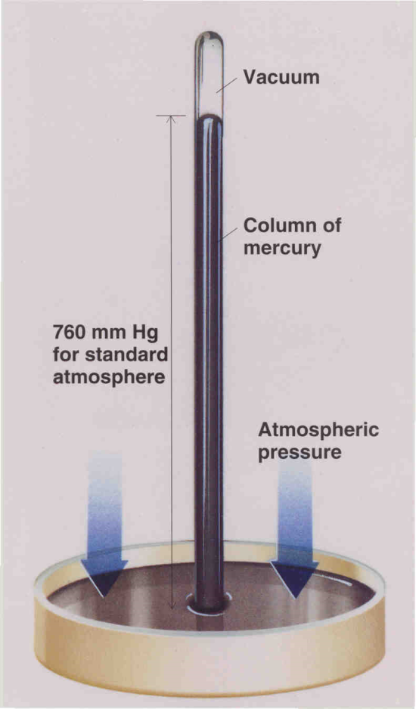
Atmospheric Pressure
We live at the bottom of an ocean of air. The pressure varies, but is close to 10⁵ N/m², or 100 kPa. (or 1 atm.)
One form of barometer has an inverted glass tube, closed at the top, open at the bottom, containing mercury, the bottom open end immersed in a pool of mercury.
The atmospheric pressure outside is balanced by the ρgh of the mercury column—above the column is a vacuum, so no pressure.

Slide 16
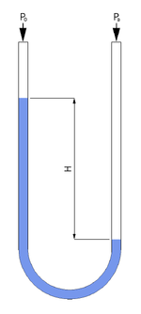
Absolute Pressure and Gauge Pressure
A common pressure gauge is the manometer, a U-tube with liquid. The pressure difference between the two sides is ρgH.
Tire pressures, for example, are measured relative to atmospheric pressure: this is called gauge pressure.
Absolute pressure is relative to a vacuum. The absolute pressure in a swimming pool = ρgh + 1 atm.

Slide 17
In September 1776, Thomas Jefferson found a mercury barometer at Monticello read 29.44 inches of mercury; taking it down to the Rivanna tobacco landing it read 30.06.
Taking air to weigh 1.17 kg/m³ and Hg 13,600 kg/m³, how high did he find Monticello to be above the Rivanna?
500 ft
550
600
650
Footnote: Jefferson found the density of air in tables he had from England. The density varies with altitude, temperature and barometric pressure.
(He bought the barometer in Philadelphia, on July the 5th of that year.)

