Slide 1
Circular Motion
Physics 1425 Lecture 9
Michael Fowler, UVa.

Slide 2
A Cannon on a Mountain
Back to Galileo one more time… imagine a powerful cannon shooting horizontally from a high mountaintop:
The path falls 5 m below a horizontal line in one second.

Slide 3
Newton’s Idea: a Really High Mountain
Imagine a very powerful cannon atop a mountain beyond the Earth’s atmosphere.
This cannonball goes so far we have to include the Earth’s curvature in our calculations!
The Earth’s surface drops 5m below a horizontal plane on traveling 8 km.
So what happens if the cannonball goes at 8 km/sec?

Slide 4
After Traveling 8 Kilometers in 1 second…
The cannonball’s velocity has slightly changed direction, adding about g = 10 m/sec downwards,
so the angle of change is given by tanθ =10/8000.
BUT the Earth’s surface underneath the cannonball has turned by precisely the same amount—and so has the direction of gravity!
The cannonball finds itself in exactly the same situation it began in: moving parallel to the surface, perpendicular to gravity, at the same height.
So what happens next?

Slide 5
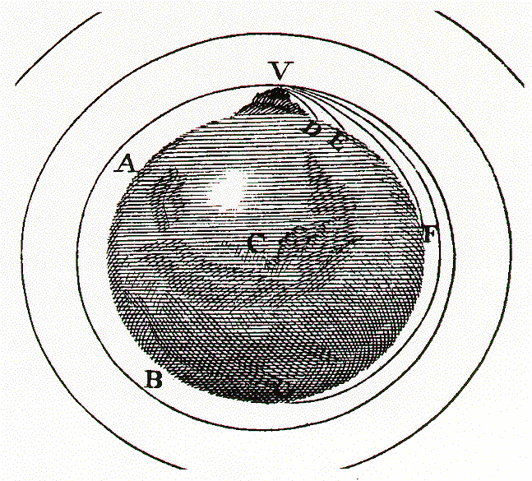
Newton’s Own Picture
Newton realized that at the right initial speed, above the atmosphere, the cannonball would circle indefinitely, accelerating towards the Earth constantly, but staying at the same height.
Link to animation

Slide 6
Acceleration in Steady Circular Motion
v
A ball circling at constant speed v goes from A to B in one second: in the limit of a small angle, distance AB = v.
The velocity vectors are perpendicular to the position vectors, so they turn through the same angle.
Hence a/v = dist AB/r = v/r,
That is,
a = v²/r
1
A
B
r
r
v
a
v

Slide 7
Dynamics of Circular Motion
Constant speed circular motion has acceleration of constant magnitude but always changing direction: it points at all times to the center of the circle.
So from , to maintain steady circular motion, a body must experience a net force of constant magnitude directed always to the center of the circle.

Slide 8
Low Earth Orbit
Newton had discovered the path of a satellite in low Earth orbit!
For a circular orbit close to Earth’s surface,
is just .
So the speed for low orbit motion is : that’s 8 km/sec, round the Earth in 80 minutes.
Newton’s next question: why does the Moon circle the Earth? Could it be the same reason? The force of gravity extends to the Moon?

Slide 9
The Moon’s Orbit
Assuming the Moon’s circular orbit is a result of gravitational pulling from the Earth, does the Moon feel F = mg as we do?
That’s easy to check: Newton found the Moon’s acceleration, using v²/r. The distance was known (384,000,000m), the speed in orbit is close to 1 km/sec (it goes around in one month) …
Bottom Line: v²/r = 0.0026m/s² = g/3600.

Slide 10
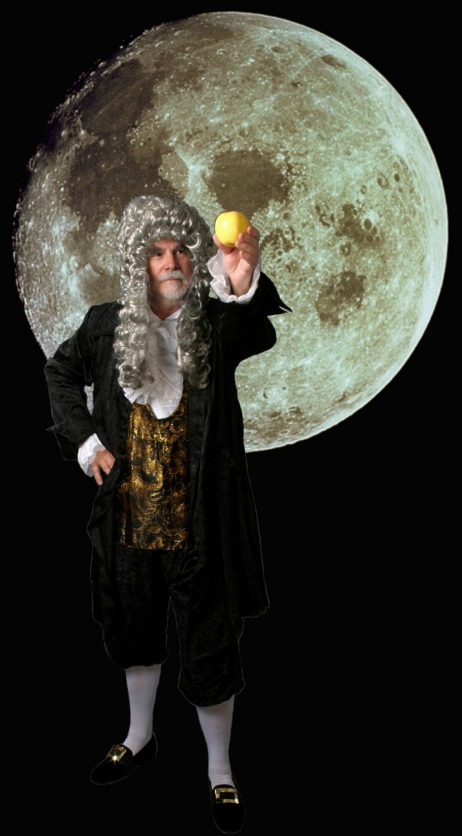
Basic Moon Facts
The apple accelerates downwards 3,600 times faster than the Moon.
The Moon is 60 times further from the center of the Earth than the apple is.
What did Newton conclude from those facts?
http://dallasvintageshop.com/?p=1097

Slide 11
The Inverse Square Law of Gravity
If the force of gravity has decreased by a factor of 3,600 on increasing the distance from the center of the Earth by a factor of 60, Newton concluded that the Earth’s gravitational force
This is the inverse square law of gravity.
We’ll get back to gravity in the next lecture …

Slide 12
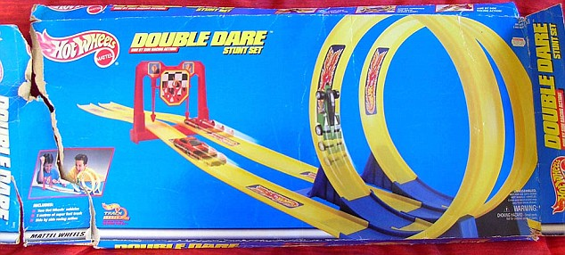
Let’s look at some different circular motion…

Slide 13
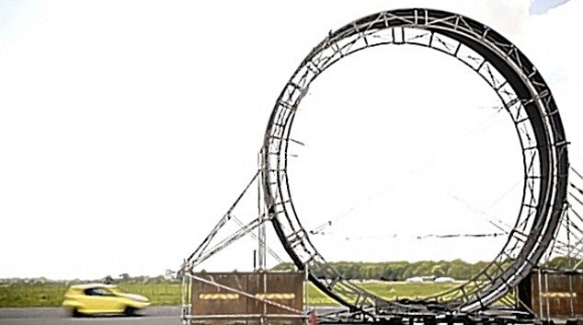
But why mess with toys—just do it!

Slide 14
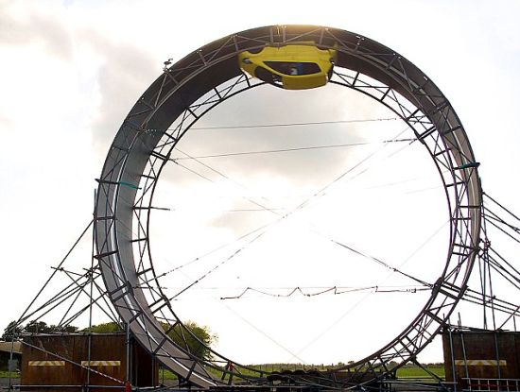
http://www.youtube.com/watch?v=wiZoVAZGgsw&NR=1
Is this for real?

Slide 15
What is the Normal Force from the Track?
At the top, is just
all directed downwards.
If
What happens for lower v at the top?
N
mg

Slide 16
Clicker Question
If the loop track has a radius of 6 meters, approximately how fast must the car be going at the top to stay on the track?
About 8 m/s (18 mph)
About 12 m/s
About 16 m/s
About 24 m/s

Slide 17
Clicker Question Answer
If the loop track has a radius of 6 meters, approximately how fast must the car be going at the top to stay on the track?
About 8 m/s (18 mph) v² = rg = 60
About 12 m/s
About 16 m/s
About 24 m/s

Slide 18
What’s the Normal Force at the Bottom?
Galileo would have understood: the speed gained swinging round the track from top to bottom is the same as the speed gained if you’d just fallen directly—and that would have been with acceleration g, a distance 2r,
Recall to make it around, so , if it’s going just fast enough to stay on track.

Slide 19
Clicker Question
If the driver has mass m, and the speed is just high enough to stay in contact with the track coasting, what is the normal force the seat exerts on him as the car enters the bottom of the loop?
mg
2mg
5mg
6mg

Slide 20
Clicker Question Answer
If the driver has mass m, what is the normal force the seat exerts on him as the car enters the bottom of the loop?
mg
2mg
5mg
6mg Recall that , so he is accelerating upwards at v²/r = 5g. His weight is mg downwards, so the upward normal force = 6mg. (And notice this 6mg doesn’t depend on r!)

Slide 21
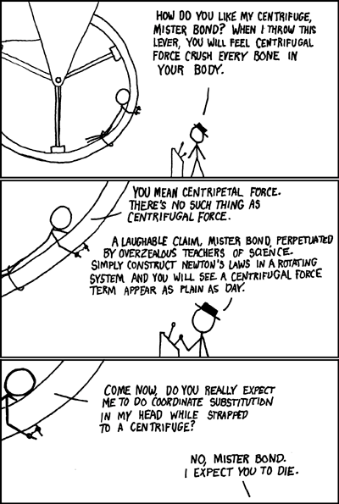
Centripetal and Centrifugal…
Circular motion is maintained by a force directed to the center of the circle: this is called the centripetal force.
But if the frame of reference is itself rotating (and hence an accelerating, noninertial frame) Newton’s Laws are different: in that frame, there is an apparent force tugging outwards from the center—the centrifugal force.
(Note: We’ll avoid that frame!)
http://imgs.xkcd.com/comics/centrifugal_force.png

